Slide 1
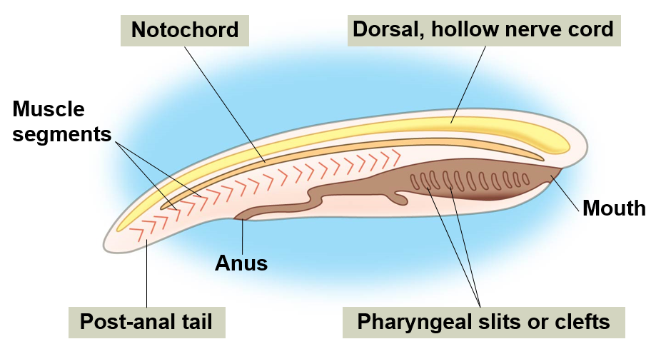
Phylum: Chordata
General characteristics: All animals in the phylum Chordata possess four anatomical features at some point in their lifecycle.
Those features include:
Notochord
Muscle attachment
Hollow dorsal nerve cord
Nerve signal transmission
Pharyngeal slits
Various functions
Post-anal tail
Movement
Three Chordata subphyla:
Urochordata
Cephalochordata
Vertebrata
Evolutionary History – The first chordates arose during the Cambrian Period approximately 550 mya.
Biogeography – World wide in nearly every habitat

Slide 2
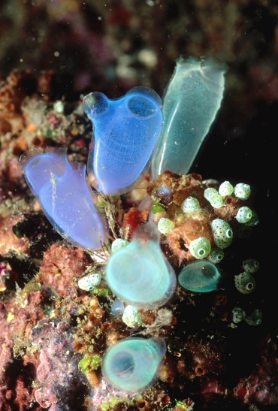
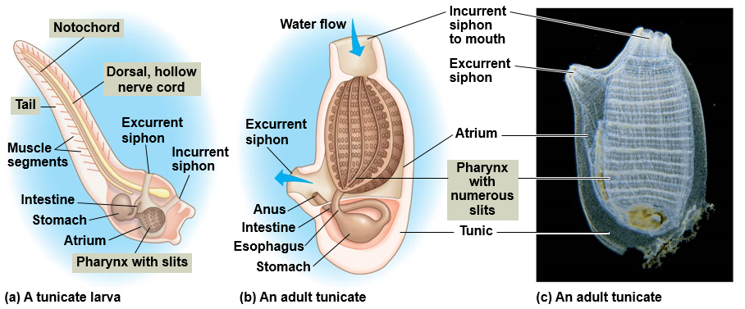
Subphylum: Urochordata
General characteristics - Tunicates or sea squirts have tadpole-like larva and adult forms encased in a tough tunic that is formed by secretion and contains cellulose. Tunicate larva have all four chordate characteristics, but only the pharyngeal slits are retained in the adult form.
Unique characteristics - They are considered to be the closest relative to vertebrates
Biogeography – Worldwide. Found in ocean waters from arctic to tropics
Habitat – Most are benthic marine
Diet – Omnivorous diet. Filter feeding on planktonic plants and animals

Slide 3
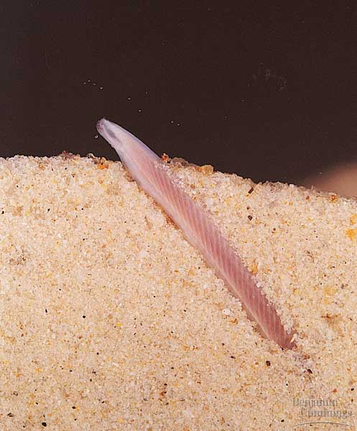
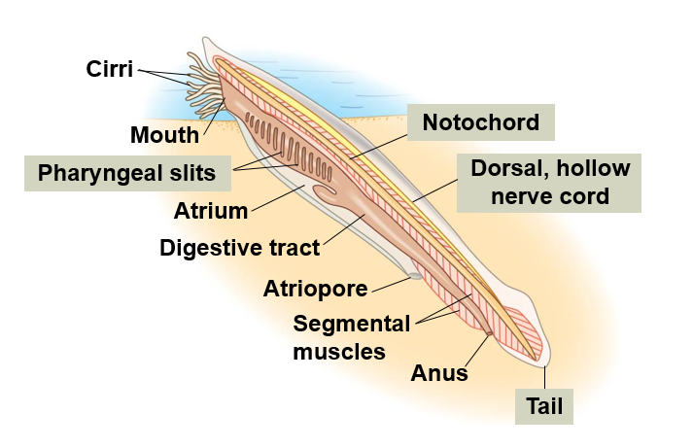
Subphylum: Cephalochordata
General characteristics – Lancelets are small (up to 3cm), slender organisms that bury themselves in sediment with just their anterior end protruding from the sediment. The lancelets contain all four chordate characteristics as an adult.
Unique characteristics – Lancelets lack a respiratory system and breath through their skin
Biogeography – Shallow temperate and tropical seas worldwide
Habitat – Benthic marine
Diet – Omnivorous diet. Filter feeding on planktonic plants and animals

Slide 4
Subphylum: Vertebrata
General characteristics - The vertebrates are animals with backbones and internal skeletons of made of cartilage or bone. Vertebrates differ from other chordates in the presence of a neural tube that forms through the fusion of the neural plate. Vertebrates contain all four chordate characteristics as an adult with some modifications.
Unique characteristics – They are free-living animals that diverged from other chordates approximately 500 mya (Cambrian).

Slide 5
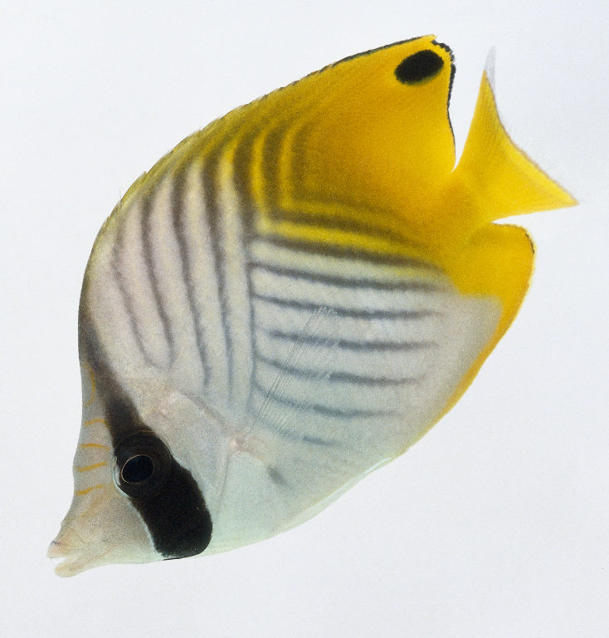
What is a Fish?
“Fish” are aquatic chordates with appendages developed as fins (when present), whose chief respiratory organ are gills and whose body is usually covered in scales. More than 27,900 fish species have been described, which is more than the number of birds, reptiles and mammals combined.
There are the four major living groups of fish:
Jawless fish
Cartilaginous Fish
Lobe-finned Fish
Ray-finned Fish

Slide 6
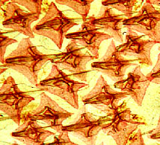
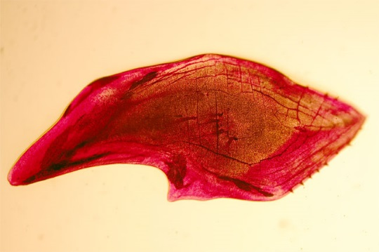
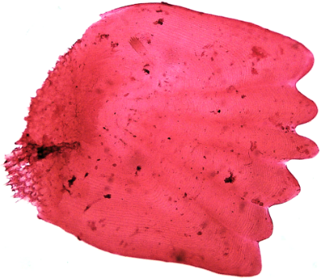
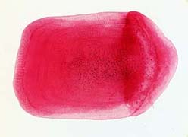
Fish Scales
Anterior end
Although most fishes have scales, the major groups of fish very in the types of scales the possess. Jawless fish lack scales, cartilaginous fish have placoid scales, lobe-finned fish have ganoid scales and ray-finned fish have ctenoid and cycloid scales. All fish scales are derived from dermal tissue, which separates them from reptile scales that are derived from the epidermal tissue.
Placoid
Ganoid
Ctenoid
Cycloid

Slide 7
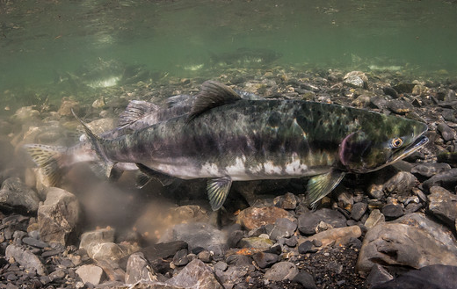
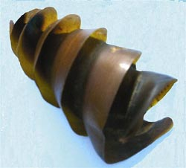
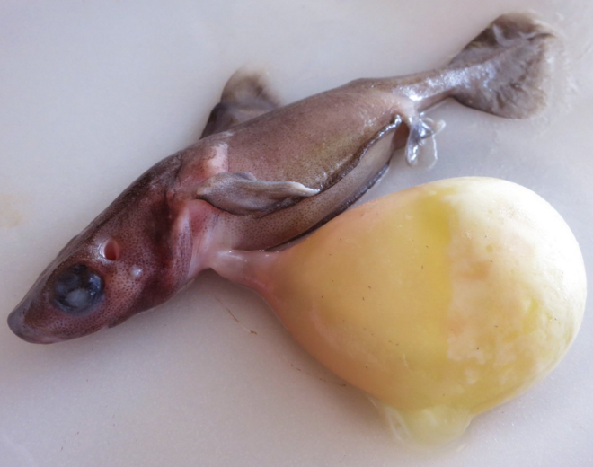
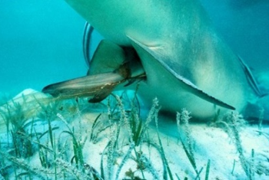
Fish Reproductive Strategies
In fish the fertilization of eggs can either happen internally or externally. Internal fertilization usually occurs through the use of modified fins, which males use to inject sperm. Embryo development occurs in one of the four ways, which are categorized as the following:
Ovuliparity: female lays unfertilized eggs, which are externally fertilized by the male
Most bony fish
Oviparity: the mother deposits internally fertilized eggs that develop and hatch outside of mother’s body
Some bony fish and some sharks
Ovoviviparity: internally fertilized eggs are retained in oviduct, and develop without any nourishment from the mother.
Few sharks
Viviparity: young develop in mother’s uterus and are nourished by the mother before being born (live birth)
Some sharks and some bony fish
Male salmon fertilizing eggs externally
Shark egg that was internally fertilized
Shark embryo that was being nourished by a yolk-sac while being retained within the mother
Female shark giving live birth

Slide 8
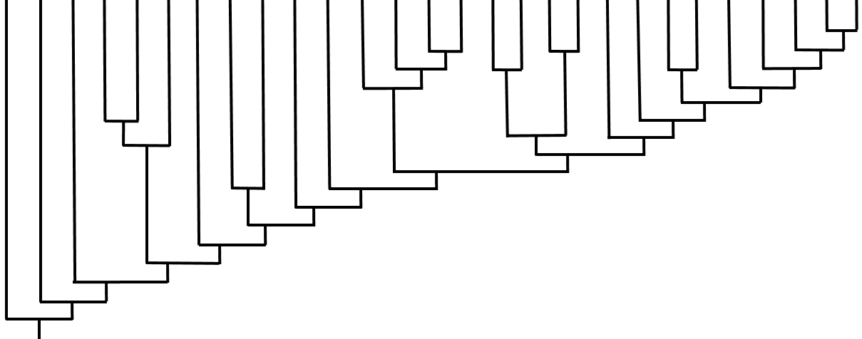
Osteoglossimorpha (Bony tongues)
Stomiiformes (Dragonfish, Hatchetfish)
Tetraodontiformes (Triggerfish, Pufferfish)
Chondrichthyes (Sharks, Skates, Rays)
Acipenseriformes (Sturgeon, Paddlefish)
Scopelomorpa (Lanternfish)
Atheriniformes (Topsmelt, Grunion)
Pleuronectiformes (Flatfishes)
Cypriniformes (Minnows, Carp)
Scombriformes (Tuna, Mackerel)
Tetrapoda (Reptiles, Birds, Mammals)
Salmoniformes (Salmon, Trout)
Syngnathiformes (Pipefish, Seahorses)
Coelocanthiformes (Caelocanth)
Clupeimorpha (Anchovy, Sardine)
Gadiformes (Cod)
Elopomorpha (Eels, Bonefish)
Characiformes (Piranha)
Osmeriformes (Smelt)
Scorpaeniformes (Rock fish, Sculpin)
Petromyzontiformes (Lamprey)
Escoiformes (Pike)
Myxiniformes (Hagfish)
Dipnoi (Lungfish)
Siluriformes (Catfish)
Perciformes (Perch and allies)
Amiiformes (Bowfin)
Lepisosteiformes (Gars)
16
20
Osteriophysi
18
19
11
15
17
10
12
Stomiatii
9
Protacanthopterygii
13
14
Acanthopterygii
Holostei
Sarcopterygii
4
6
8
Teleostei
2
1
7
Actinopterygii
5
Osteichthyes
Synapomorphies: 1) Slime production 2) Ammocoetes larvae. 3) Jaws. 4) Cartilaginous skeleton 5) Ossified endoskeleton. 6) Lobed fins. 7) Rayed-fins. 8) Mobile pre-maxilla (jaw protrusion), uroneural bone. 9) Leptocephalus larve. 10) Bony tongue 11) Inner ear to gas bladder connection. 12) Weberian apparatus. 13) Adipose fin, lack of jaw protrusion. 14) Spiny rays on first dorsal, ascending process, pectoral and pelvic girdle connection, pharyngeal dentition. 15) Fused jaw, bony plates. 16) Finlets. 17) Flattened body. 18) Jaw teeth. 19) Lateral pectoral fins, abdominal pelvic fins. 20) Bony plate/spines on cheek.
3
Gnathostomata

Slide 9
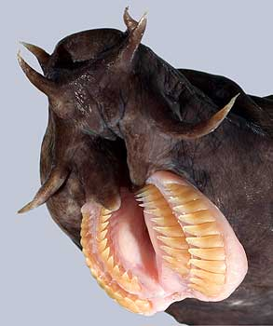
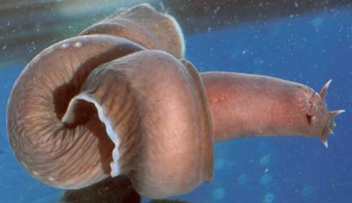
Superclass: Agnatha Order: Myixiniformes Species: Hagfish
General characteristics – Fish in the superclass agnatha lack scales, jaws and paired appendages.
Unique characteristics – Hagfishes differ from lampreys in that they lack true eyes and a stomach, and have characteristic barbels around their mouths. Hagfish are unique in that they can secrete large quantities of slime or mucus when attacked. Hagfish will often tie themselves in a knot to help release the slime or to provide leverage when feeding.
Biogeography – Temperate ocean waters worldwide
Habitat – Benthic deep sea
Diet – Carnivorous diet. They are benthic scavengers that find their prey using their sense of smell. They will often enter natural openings of dead or dying fish and marine mammals that have sunk to the bottom of the ocean.
Barbels

Slide 10
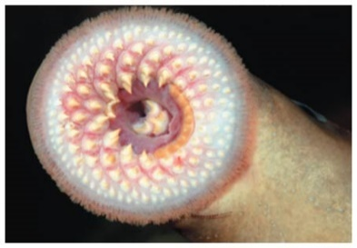
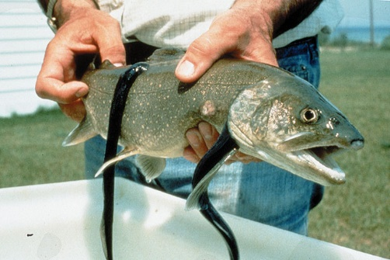
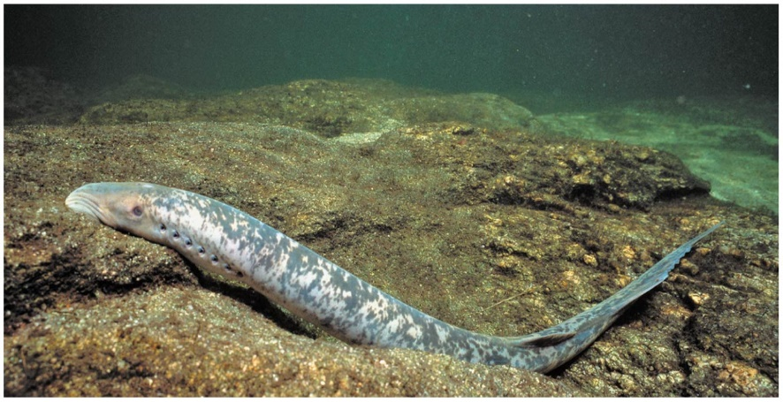
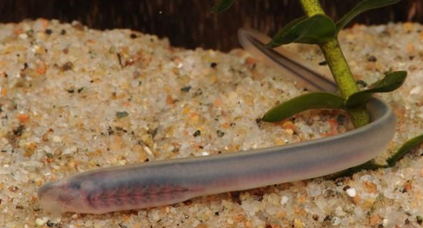
Superclass: Agnatha Order: Petromyzontiformes Species: Lamprey
General characteristics – Fish in the superclass agnatha lack scales, jaws and paired appendages.
Unique characteristics – The lamprey larvae, called ammocoetes, are found in burrows in freshwater rivers and streams, where they obtain food by filter feeding. When transitioning to the adult form the larvae must go through metamorphosis where the entire digestive system must be restructured.
Biogeography – Temperate marine and fresh waters worldwide
Habitat – Lampreys typically live in the ocean and must migrate up fresh water rivers to spawn (anadromous). Ammocoetes are found in freshwater rivers and streams.
Diet - Some adult lampreys are parasitic and feed by attaching their mouth to a fish, secreting an anticoagulant into the host, and feeding on the blood and tissues of the host. Ammocoetes are filter feeders.
Ammocoete larva

Slide 11
Superclass: Gnathostomata
This superclass includes the jawed vertebrates. Jaws likely evolved from the skeletal supports of the pharyngeal slits which were used in filter feeding. The evolution of jaws allowed for the utilization of different food types, which facilitated the radiation and diversification of vertebrates.

Slide 12
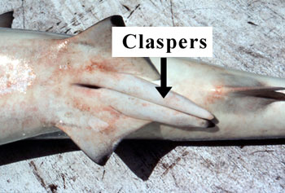
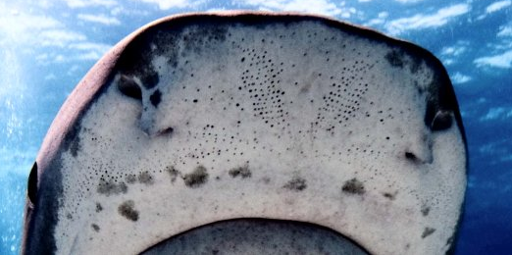
Class: Chondrichthyes
General characteristics – Fish in the class Chondrichthyes all lack true bone and have a skeleton made of cartilage, which is not a primitive characteristic. Chondricthyans have tough skin covered with placoid scales, large, buoyant livers and spiral valve intestines.
Unique characteristics – Most chondrichtyans have a highly developed sensory organ for sensing prey called the Ampullae of Lorenzini, which helps them sense the electrical fields given off by their prey. Male and female Chondrichthyans can be easily distinguished by the presence or absence of claspers. Only male sharks have claspers, which are extensions of the pelvic fins used to transfer sperm during internal fertilization.
Evolutionary history – Fossil evidence suggests chondrichthyans diverged in the early Devonian approximately 419 mya
Two Chondrichtyes subclasses:
Elasmobranchii (sharks, skates, and rays) have 5-7 gill openings, a ridged dorsal fin and an upper jaw free from skull
Holocehphali (chimeras) have a gill cover over a single gill opening, a spine in front of soft dorsal fin, and an upper jaw fused to their skull
Placoid scales
Ampullae of Lorenzini

Slide 13
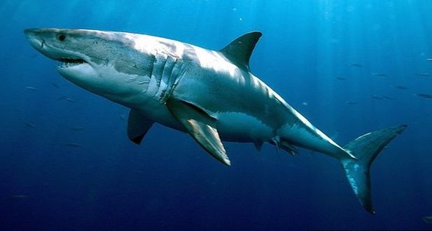
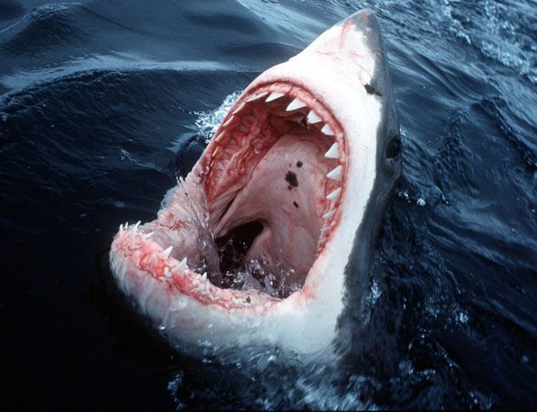
Subclass: Elasmobranchi Order: Lamniformes Species: Great white shark
General characteristics – The great white shark measures up to 20 feet and can weigh up to 4200 lbs. Female great whites are ovoviviparous.
Unique characteristics – The great white has been labeled a “man eater” however in the last 100 years more people in the U.S. have been killed by dogs than by great white sharks.
Biogeography - They are found in worldwide in coastal and offshore waters ranging between 54 to 75 degrees F.
Habitat – Surface waters where enough light penetrates to sustain photosynthesis, which is known as the epipelagic zone
Diet – Carnivorous diet. They usually eat large bony fish, smaller sharks, dolphins, seals, and sea lions.

Slide 14
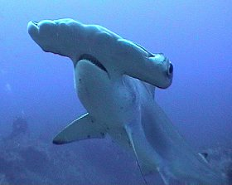
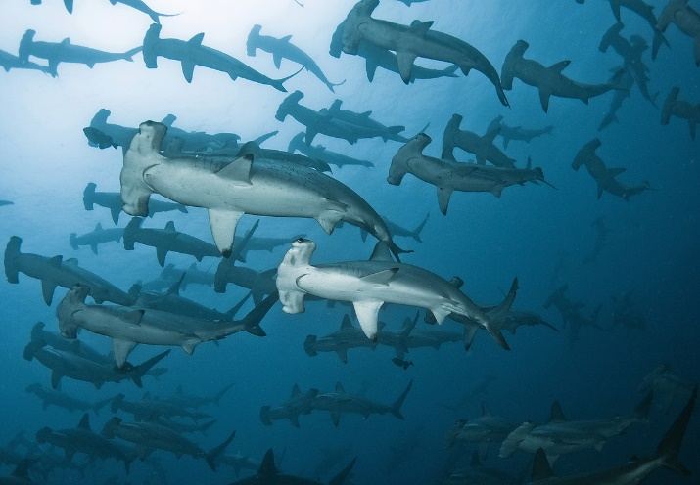
Subclass: Elasmobranchi Order: Carcharhiniformes Species: Hammerhead shark
General characteristics – The hammerhead shark measures up to 18 feet and can weigh up to 1000 lbs. Female hammerheads are viviparous.
Unique characteristics – The shape of the head is thought to spread their receptors across a larger area making them 10 times more likely to detect prey.
Biogeography - They are found in tropical and subtropical waters worldwide
Habitat – Along shorelines and on continental shelfs
Diet – Carnivorous diet. They usually eat fish, rays, other sharks, cephalopods and crustaceans.

Slide 15
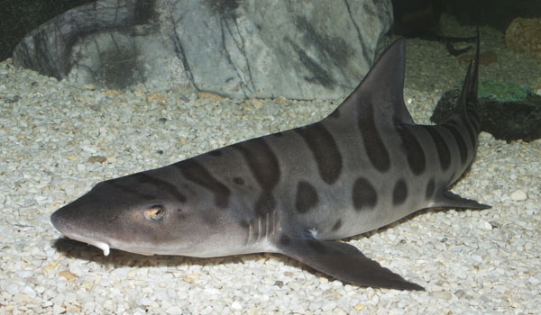
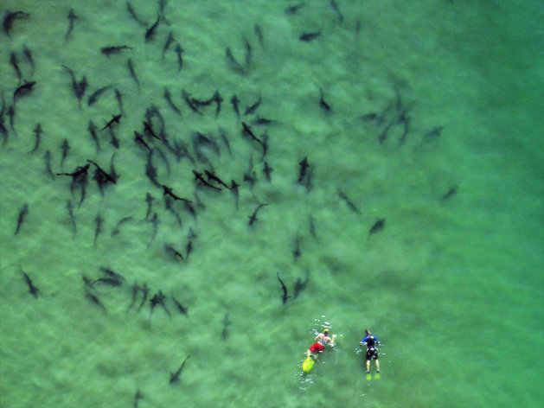
Subclass: Elasmobranchi Order: Carcharhiniformes Species: Leopard shark
General characteristics – The leopard shark can measure up to 6.5 feet and can weigh up to 40 lbs. Female leopard sharks are viviparous.
Unique characteristics –The leopard sharks have more red blood cells when compared to other close relatives, which may allow them to process more oxygen in oxygen-poor estuarine environments.
Biogeography – Pacific coast from Oregon to Baja California
Habitat - They are often found large schools in shallow coastal regions along the coast, including bays and estuaries
Diet – Carnivorous diet. They usually eat small bony fish, worms, crustaceans, and clams.

Slide 16
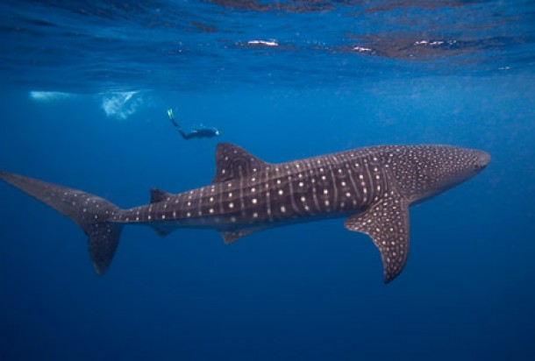
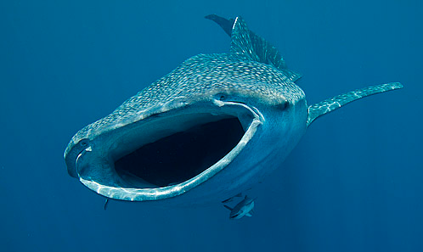
Subclass: Elasmobranchi Order: Orectolobiniformes Species: Whale shark
General characteristics – The whale shark is the largest fish in the ocean and measures up to 40 feet and can weigh up to 47,000 pounds. Whale sharks are ovoviviparous and have been found with more than 300 pups.
Unique characteristics –The whale shark can filter 600 cubic meters (160,000 gallons) of water an hour.
Biogeography - They are found in all tropical and warm-temperate oceans throughout the world.
Habitat – Open ocean
Diet – Omnivorous diet. They usually are filter feeders eating enormous amounts of plankton.

Slide 17
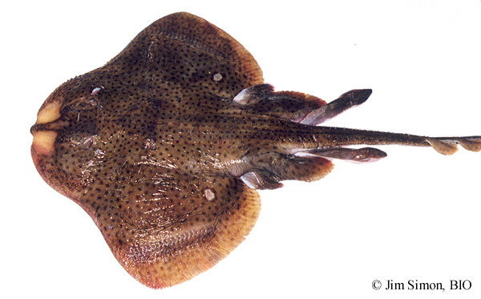
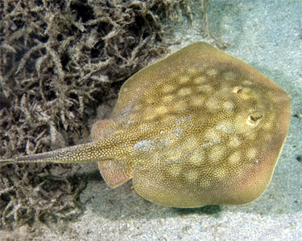
Subclass: Elasmobranchii Order: Rajiformes (skates) Myliobatiformes (rays)
Thorns
Both skates and rays are flat bottom-dwelling organisms.
Skates have a tiny caudal fin with no stinging spines, thorns on their back, with each pelvic fin divided into two lobes. Skates are oviparous or ovoviviparous.
Rays have a slender whip-like tail without a caudal fin and a stinging spine near the end of the tail, no thorns on their back, with one lobe for each pelvic fin. Most rays are ovoviviparous.
Pelvic fin with two lobes
Stinging spine
Single lobed pelvic fin

Slide 18
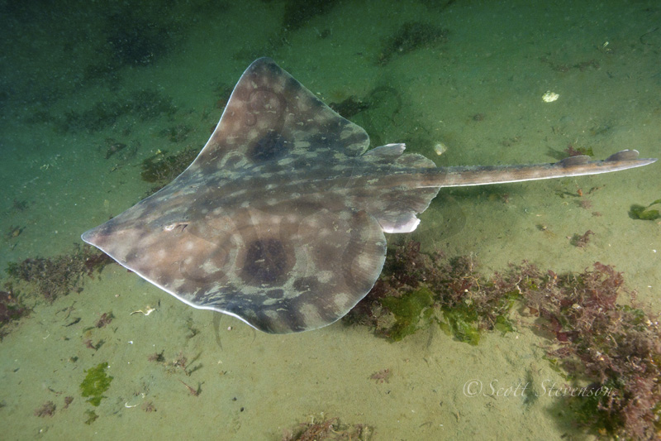
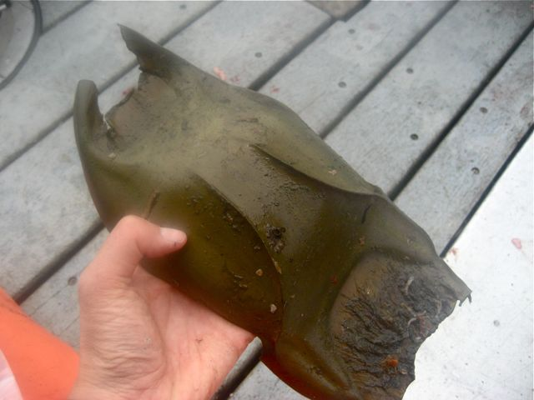
Subclass: Elasmobranchi Order: Rajiformes
Species: Big skate
General characteristics – Skates have a tiny caudal fin with no stinging spines, thorns on their back, with each pelvic fin divided into two lobes. The big skate is known to grow to 2.4 meters in length (~8 feet).
Unique characteristics – Most skate species are oviparous, and produce eggs encased in a hard shell, which are often called a mermaids purse. The big skate producing the largest eggs of any skate.
Biogeography – Skates are found in oceans worldwide. The big skate ranges from Alaska to Baja California
Habitat – Skates are typically found in coastal bays, estuaries and along the continental shelf.
Diet – Carnivorous diet. Skates feed on polycheate worms, mollusks, crustaceans and small fishes.

Slide 19
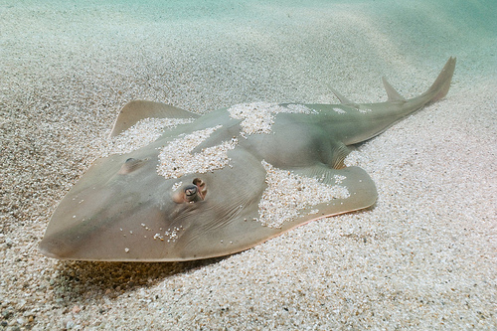
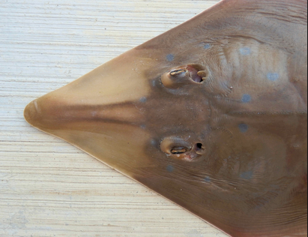
Subclass: Elasmobranchi Order: Rajiformes
Species: Shovelnose guitarfish
Shovelnose guitarfish
General characteristics – Guitarfish have an elongated body with small ray like wings. Similar to other skates and rays, guitarfish have holes behind their eyes called spiracles that they use to take in water for respiration while buried in the sand.
Unique characteristics – Unlike other rays that swim with their pectoral fins, guitar fish swim using their shark-tail tail.
Biogeography - Guitarfish can be found in tropical and temperate marine waters worldwide. The shovelnose guitarfish can be found from central California to the Gulf of California where they have existed for more than 100 million years.
Habitat – Coastal soft bottoms, including bays and estuaries
Diet – Carnivorous diet. Like other guitarfish, they are bottom feeders, preferring small crustaceans, clams and worms.
Spiracle

Slide 20
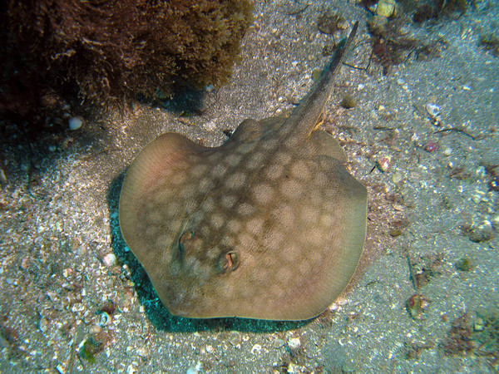
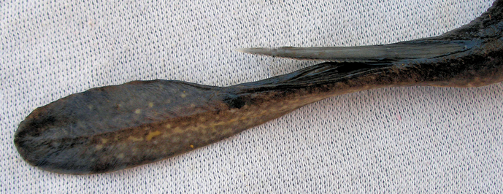
Subclass: Elasmobranchi Order: Myliobatiformes
Species: Round stingray
General characteristics - The round stingray is the most common ray species in the coastal waters off of southern California.
Unique characteristics - They have a venomous sting on their tail with rear facing barbs, that is used to inject a painful venom into would be predators or beachgoers.
Biogeography – Stingrays are found in tropical and subtropical marine waters worldwide, with few species occupying freshwater habitats. The round stingray ranges from northern California to Panama.
Habitat - Coastal soft bottoms, including bays and estuaries
Diet – Carnivorous diet. They feed on crabs as juveniles then shift to benthic mulluscs and polycheate worms as adults.
Venomous sting

Slide 21
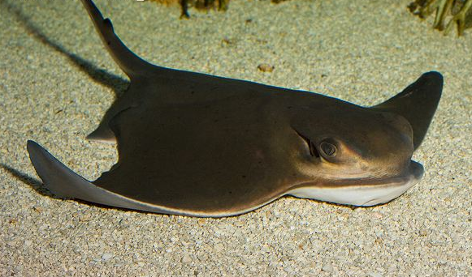
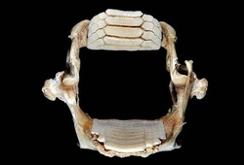
Subclass: Elasmobranchi Order: Myliobatiformes
Species: Bat ray
General characteristics – Bat rays can grow to a wingspan of about 6ft and weigh a little over 200 pounds
Unique characteristics - Bat rays are considered euryhaline because they can withstand a wide range of salinities.
Biogeography - Oregon down to the Gulf of California
Habitat - The bat ray is typically found along coastal sandy bottoms in bays and estuaries
Diet – Carnivorous diet. They have rows of flat teeth perfect from crushing and grinding their mollusk and crustacean prey.

Slide 22
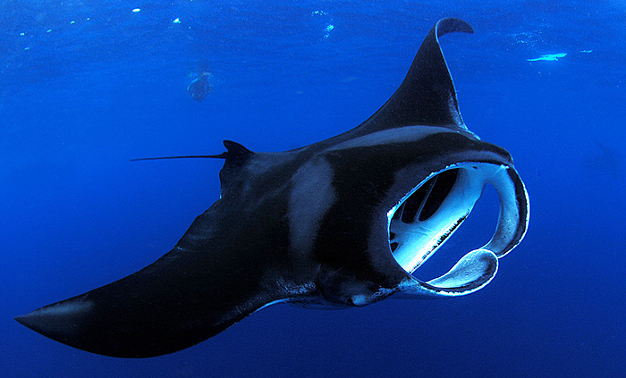
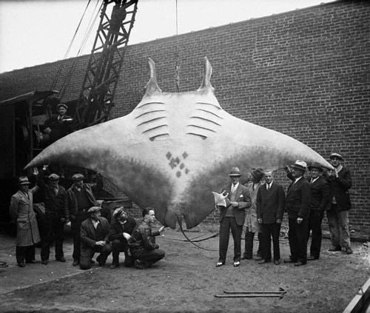
Subclass: Elasmobranchi Order: Myliobatiformes
Species: Manta ray
General characteristics - The manta ray is the largest species of ray, with the largest known specimen measuring 7.6 m (about 25 ft) across.
Unique characteristics - Manta rays are believed by some to have evolved from bottom-feeding rays, but have adapted to become filter feeders in the open ocean.
Biogeography – Mantas can found in tropical and subtropical waters worldwide.
Habitat - Manta rays are pelagic (open ocean)
Diet – Omnivorous diet. Filter feed planktonic algae and animals in water column.

Slide 23
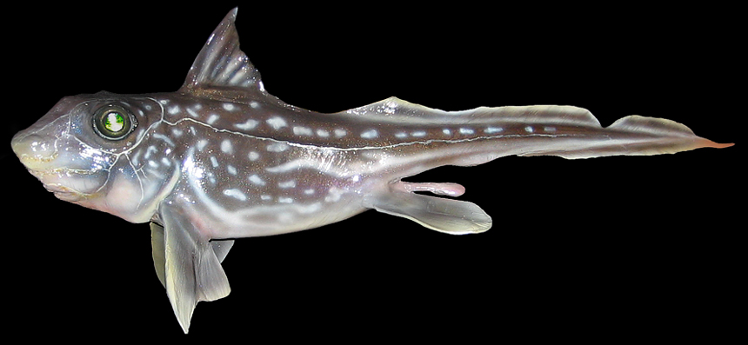
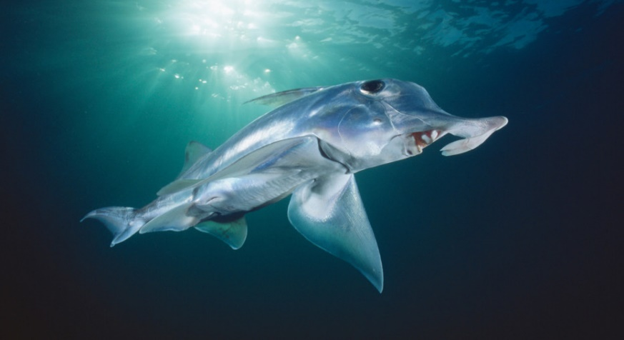
Subclass: Holocephali Order: Chimaeriformes
Species: Chimaera
General characteristics - Chimaeras are often called ratfish or rabbit fish. They differ from sharks, skates and rays in that their upper jaws are fused with their skulls, they have separate anal and urogenital openings, and they lack the many sharp and replaceable teeth of sharks, having instead a few large permanent grinding tooth plates.
Unique characteristics - The tooth plates are used to crush hard-bodied prey such as crabs, clams, and echinoderms.
Biogeography – Temperate oceans worldwide
Habitat - They are found in cold water often at great depths.
Diet – Carnivorous diet. They feed primarily on benthic invertebrates.

Slide 24
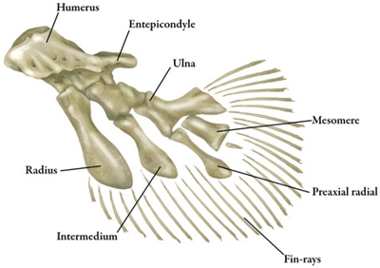
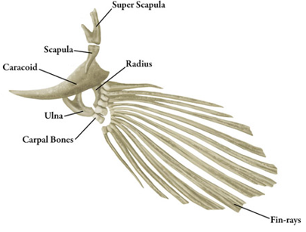
Osteichthyes
General characteristics – The “Osteichthyes” all have a skeleton made of true bone. Their skin is covered with ganoid, cycloid or ctenoid scales. They also have an operculum (a hard covering over the gills), which helps them breathe without having to swim, and a swim bladder, which helps the body create a neutral balance between sinking and floating.
Evolutionary history – Fossil evidence suggests chondrichthyans diverged in the early Devonian approximately 419 mya
There are two classes in this group:
Sarcopterygii - Lobe-finned fish
Actinopterygii - Ray-finned Fish
Lobed fin
Rayed fin

Slide 25
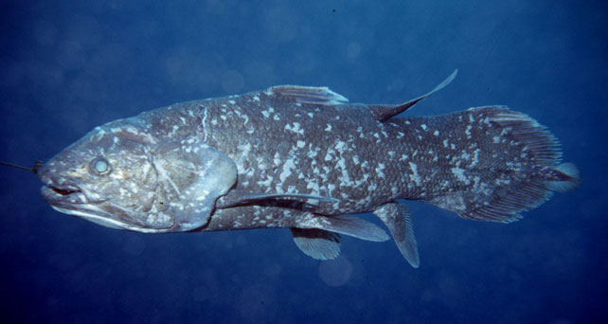
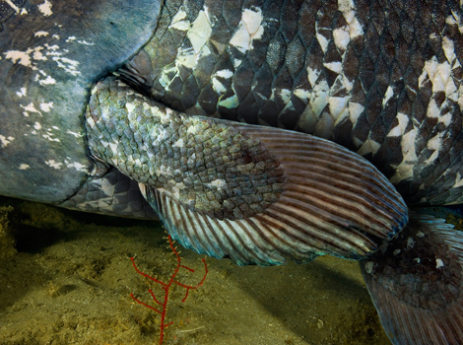
Class: Sarcopterygii Subclass: Actinistia Species: Coelacanth
General characteristics - Coelacanths are lobe-finned fish, with pectoral and anal fins made up of fleshy stalks supported by bones. Coelacanths have a unique tail that is divided into three lobes. Coelacanths were thought to be extinct before being rediscovered in 1938.
Unique characteristics - Coelacanths have a special electro-receptive device called a rostral organ in the front of the skull, which is likely used to detect prey.
Biogeography - Coelacanth populations have been found near Indonesia and South Africa.
Habitat – Rocky bottom at depths of 100m to 300m deep
Diet – Carnivorous diet. Coelacanths are opportunistic feeders, that feed on cephalopods, fish and small sharks.
Lobed pectoral fin

Slide 26
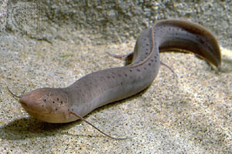
Class: Sarcopterygii Subclass: Dipnoi Species: Lungfish
African lungfish
General characteristics - Lungfish are fresh water lobe-finned fish, which are best-known for their ability to breathe air using a lung that is homologous to tertapods. They have paired pectoral and pelvic fins and a single caudal fin.
Unique characteristics - African and South American lungfish are capable of surviving seasonal desiccation of habitats by burrowing into mud and estivating throughout the dry season.
Biogeography - Today, they are found in Africa, South America and Australia.
Habitat – Freshwater rivers and lakes.
Diet – Omnivorous diet. They have a diverse die of fish, insects, mollusks, worms, crustaceans, and plant material
Australian lungfish

Slide 27
Class Actinopterygii Order: Acipenseriformes Species: Sturgeon
Lake sturgeon
General characteristics - The most primitive of the ray-finned fishes, fish in the order Acipenseriformes (sturgeon and paddlefish) have a mostly cartilaginous skeleton, spiral valve intestine, no scales and a herterocercal caudal fin similar to many chondrichthians.
Unique characteristics - Many sturgeon species are threatened due to overexploitation of their eggs or roe, which is makes up some of the most prized caviar.
Biogeography – Temperate waters in North America and Europe.
Habitat – Most are anadromous, living in deltas and estuaries then migrating upstream to spawn, however some have evolved to live exclusively in freshwater habitats
Diet – Carnivorous diet. Sturgeon are benthic feeders that use four barbels on their snout to locate mollusks, crustaceans and small fish.
Barbels
Herterocercal caudal fin
The collection of sturgeon roe before being sold as caviar.

Slide 28
Class Actinopterygii Order: Acipenseriformes Species: Paddlefish
General characteristics – Paddlefish have a mostly cartilaginous skeleton, spiral valve intestine, no scales, and a herterocercal caudal fin similar to many chondrichthians. There are two extant species of paddlefish, the American paddlefish and the Chinese paddlefish. Both species have declined sharply due to overfishing and pollution, with the last sighting of a Chinese paddlefish in the wild in 2007, it is now believed by many to have gone extinct.
Unique characteristics – The elongated bill called a rostrum, contains electroreceptors, which can be used to detect the electric fields given off by prey items in the water column.
Biogeography – Mississippi River basin in U.S and Yangtze River basin in China
Habitat – Freshwater rivers
Diet - Of the two extant species of paddlefishes, the American species feeds by filter feeding, whereas the Chinese paddlefish are piscivorous (fish eating).
American paddlefish
Chinese paddlefish

Slide 29
Class: Actinopterygii Infraclass: Holostei
The Holostei infraclass represents a primitive clade of the ray finned fish with lightly ossified endoskeletons. The infraclass includes the bowfin and seven extant species of gar. The bowfin and gar species within Holostei are typically found in brackish conditions and have adaptations in their swim bladders to obtain extra oxygen from the air when in hypoxic conditions.
The two orders in Holostei include:
Lepidosteriformes – Gars
Amiiformes - Bowfin
Bowfin
Gar

Slide 30
Infraclass: Holostei Order: Lepisoteriformes Species: Gar
Spotted gar
General characteristics - Gars are one of the few species of fish with ganoid scales. All gars are ambush predators with long snout and sharp teeth.
Unique characteristics - Gars living in stagnant or warm water where the concentration of oxygen in the water is typically low, will often surface periodically to take a gulp of air. Their pharynx opens to a highly vascularized swim bladder that can function as a lung.
Biogeography - Eastern North America, Central America, and the Caribbean islands
Habitat - Gars inhabit fresh, brackish, and occasionally marine waters
Diet – Carnivorous diet A voracious predator that preys on fish and aquatic invertebrates
Alligator gar
Ganoid
scales

Slide 31
Infraclass: Holostei Order: Amiiformes Species: Bowfin
General characteristics - The bowfin is the single extant species within Amiiformes. Bowfin have cycloid scales similar to Teleosts.
Unique characteristics - Like the gar the bowfin’s swim bladder functions much like a lung, allowing this fish to gulp air when dissolved oxygen levels become dangerously low in the weed beds where it lives. Bowfin are unique in that they have a large gular plate on the underside of their jaw and swim via an undulating dorsal fin.
Biogeography – Their distribution is restricted to eastern North America.
Habitat – Freshwater rivers and lakes
Diet – Carnivorous diet. Bowfin are voracious predators that feed on fish and aquatic invertebrates.
Gular plate

Slide 32
Class: Actinopterygii Infraclass: Teleostei
General characteristics - Teleosts make up 96% of all fish species. Teleost fishes differ greatly in their morphology, behavior and feeding habits, making them the most diverse taxon of all vertebrates. Two characteristics unite all teleost fishes. They have movable maxilla and premaxilla bones in their jaw, which allows for jaw protrusion. Shooting the jaw forward causes a negative suction that sucks prey into their mouth. Teleosts also have a uroneural bone, which provides added support to the homocercal caudal fins of teleosts.
Biogeography – Teleosts are found in nearly every marine and freshwater habitat worldwide.
List of Teleost Superorders:
Elopomorpha
Osteoglassimorpha
Clupamorpha
Osteriophysi
Protacanthopterygii
Stomatii
Scopelomorpha
Acanthopterygii
Jaw protrusion

Slide 33
Class: Actinopterygii Infraclass: Teleostei
List of Teleost Superorders and their distinguishing characteristics:
Superorder: Elopomorpha
Leptocephalus larvae
Superorder: Osteoglossomorpha
Bony tongue
Superorder: Clupeomorpha
Pneumatic duct connecting the gas bladder to the gut
Superorder: Ostariphysi
Weberian apparatus, alarm response

Slide 34
Class: Actinopterygii Infraclass: Teleostei
List of Teleost Superorders and their distinguishing characteristics:
Superorder: Protacanthopterygii
Adipose fin. Lack upper jaw protrusion
Superorder: Stomiatii
No distinguishing characteristics shared by this group
Superorder: Scopelomorpha
Deep water fish. Bioluminescent. Large eyes
Superorder: Acanthopterygii
Spiny rays on first dorsal, ascending process, pectoral and pelvic girdle connection, pharyngeal dentition

Slide 35
Superorder: Osteoglossomorpha Order: Osteoglossiformes Species: Bony tongues
Arowana
General characteristics - Bony tongues get their name from a toothed bone on the floor of the mouth that they use to bite against teeth on the roof of the mouth.
Unique characteristics - Some arowana are mouthbrooders that incubate their eggs in their mouth. Elephant fish can produce a weak electrical field that allows them to sense the environment around them in unclear waters.
Biogeography – Found in freshwater habitats on all major continents except Europe.
Habitat - Most are found in tropical freshwater habitats
Diet – All bony tongues are carnivorous.
Elephant fish

Slide 36
Superorder: Elopomorpha Order: Anguilliformes Species: Moray eel
Leptocephalus larvae
General characteristics - All elopomorphs are characterized by the presence of laterally flattened, transparent larvae called leptocephalus larvae.
Unique characteristics - Moray eels lack an operculum so their mouth is often open (and moving) to help water circulate through the gills. Moray eels have a mobile set of pharyngeal teeth that spring forward an pull prey into their throat.
Biogeography – Elopomorphs are found in marine habitats worldwide. Moray eels can be found from Point Conception down to southern Baja California.
Habitat – The California moray eel is typically wedged in a crevice in rocky bottom reefs along the coast
Diet – Carnivorous diet. Morey eels are generalist predators that eat fish, molluscs and crustaceans.

Slide 37
Superorder: Clupeomorpha Order: Clupeiformes Species: Sardines and Anchovies
General characteristics - Like most clupeids, anchovies and sardines are small, silvery schooling fish that are both commercial important to humans and represent a primary food source for many marine predators. The northern anchovy can be distinguished from the Pacific sardine by its large mouth, and lack of spots along the side of their body.
Unique characteristics - Clupeids have a pneumatic duct connecting their gut to the gas bladder which allows them to quickly regulate the pressure on their gas bladder while rapidly ascending in the water column.
Biogeography – Clupeids are found in marine habitats worldwide.
Habitat – Almost all clupeids are open-ocean, schooling fish, near surface waters (epipelagic)
Diet – Carnivorous diet. Most are filter feeders that use fine, sieve-like projections on the anterior end of their gills, called gill rakers, to capture small planktonic organisms (planktivory).
Northern anchovy
Pacific sardine

Slide 38
Class: Actinoptrygii Superorder: Ostariophysi
Osteriophysians dominant freshwater habitats worldwide, accounting for about 64% of all freshwater species. Most ostariophysians release an a pheromone when injured that elicits an alarm response from other ostariophysians in the vicinity. Another adaptation that led to the success of ostariophysians is the Weberian apparatus, which consists of a set of bones (occicles) that pass sound from the swim bladder to the inner ear. This specialized connection gives ostariophysians better hearing than many other fish species.
The superorder Osteriophysi includes the orders:
Cypriniformes
Charasiformes
Siluriformes
Gymnotiformes

Slide 39
Superorder: Ostariphysi Order: Cypriniformes Species: Carp and minnows
General characteristics - The order Cypriniformies contains the largest family of any vertebrate group, Cyprinidae, which includes carp and minnows.
Unique characteristics – The common carp is considered one of the 100 worst invasive species because they have spread through most freshwater systems and have led to the decline of many native fish populations. The feeding behavior of the common carp, often disrupts the growth of aquatic vegetation in shallow freshwater habitats. The vegetation in many shallow areas provide cover for larval and juvenile fish, and also act as a substrate where many native fish deposit their eggs.
Biogeography – Cyprinids are found on every continent except South America Originally from Europe and Asia, but has been introduced to North America
Habitat - Freshwater lakes and rivers
Diet – Omnivorous diet. Aquatic vegetation and benthic invertebrates
Common carp
Common carp at Lake Mead, NV

Slide 40
Superorder: Ostariphysi Order: Characiformes Species: Piranha
General characteristics – Characids are a large group of freshwater fish with diverse ecological and anatomical characteristics. Characids have replacement dentition and typically have an adipose fin. One of the best known characids is the red-bellied piranha which are normally only 6-10 inches long. Piranha are known for their sharp teeth and an aggressive appetite for meat, although they generally pose no threat to humans. Humans frequently swim in piranha-infested waters without attacks. Their aggressiveness may increase due to limited food but rarely do they eat animals much larger than themselves.
Unique characteristics – Piranha are similar to sharks in their ability to detect blood in the water.
Biogeography – Characids are primarily fond in tropical freshwater systems worldwide, whereas the red-bellied piranha are limited to South America.
Habitat – Freshwater rivers and lakes
Diet – Characids have diverse diets including carnivores, planktivores, detritivores and herbivores, although piranhas are best know for their carnivorous diet.
Adipose fin

Slide 41
Superorder: Ostariphysi Order: Siluriformes Species: Catfish
“Naked” catfish
General characteristics - Catfish are named for their cat-like whiskers, called barbels, which have chemoreceptors that allow them to sense their environment. Unlike most other fish, catfish lack scales, and are either naked (skin only) or have heavy armor-like plates called scutes.
Unique characteristics - Catfish species have the greatest range in size among any group of bony fish. Some species reach sexual maturity at 1cm in length while the giant Mekong catfish can grow to 9 feet in length and weigh as much as 640lbs. Most catfish have strong spines at the start of their dorsal and pectoral fins that can possess a stinging venom, while others can give off a strong electrical charge.
Biogeography – Catfish are found in marine and freshwater habitats worldwide
Habitat – Most live in freshwater rivers and lakes, however a few species live in coastal waters
Diet – Omnivorous diet, eating aquatic plants and algae, as well as aquatic invertebrates and small fish
Armored catfish

Slide 42
Superorder: Ostariphysi Order: Gymnotiformes Species: Knifefish
General characteristics – Knife fish are characterized by their elongate, compressed body, extremely long anal fin and lack of a dorsal or caudal fin. They are slow moving fish that swim using undulations of their anal fin.
Unique characteristics - They have specialized organs derived from muscle cells that are adapted to the generation of electric fields. Knife fish use these electric fields for communication, navigation, and protection against predators.
Biogeography – Restricted to Central and South America
Habitat – Freshwater lakes and streams
Diet – Carnivorous diet. Knife fish primarily feed on benthic invertebrates

Slide 43
Class: Actinopterygii Infraclass: Teleostei Superorder: Protacanthopterygii
Adipose fin
Fish in the superorder Protacanthopterygii are specialized predators of smaller animals. Most protocanthopterygian fishes have an adipose fin and lack a protrusible upper jaw. Many are both commercially important to humans and represent important game fish.
The superorder Protacanthopterygii includes the orders:
Salmoniformes – Salmon and Trout
Escohiformes - Pike
Chinook salmon
Northern pike

Slide 44
Superorder: Protacanthopterygii Order: Salmoniformes Species: Salmon
Male sockeye ocean phase
General characteristics - Most salmon species are anadromous, a term used to describe the life cycle where fish are born in fresh water, migrate to the ocean, then return to fresh water to reproduce. Many dams have fish ladders that allow salmon to “climb” over the dam. Atlantic and Pacific salmon species are both commercially important to humans and represent an popular sport fish.
Unique characteristics - Many salmon species undergo drastic morphological changes during their breeding run, where some species can swim hundreds of miles upstream to their natal streams to spawn.
Biogeography – Northern hemisphere and Argentina
Habitat – Freshwater streams as a juvenile, coastal ocean waters as an adult
Diet – Carnivorous diet, eating aquatic invertebrates when a juvenile and fish as an adult
Male sockeye breeding phase
Fish ladder

Slide 45
Superorder: Protacanthopterygii Order: Salmoniformes Species: Rainbow trout
Rainbow trout
General characteristics - Trout are closely related to salmon and are often found within the same genera. Like salmon, trout have fins entirely without spines, and also have an adipose fin.
Unique characteristics - Rainbow trout are popular game fish that has been introduced to many freshwater systems in the U.S. Rainbow trout have become a problem in many areas where they hybridize with native trout species leading to a loss of genetic purity of native fish populations, a term known as genetic pollution.
Biogeography – Native to North America and Asia, but introduced to Europe, Australia, New Zealand, and South America
Habitat - Freshwater lakes and streams, however a few species are anadromous
Diet - Carnivorous diet, eating aquatic invertebrates when a juvenile and fish as an adult
Rainbow trout X Cutthroat trout hybrid
Cutthroat trout

Slide 46
Superorder: Protacanthopterygii Order: Esociformes Species: Pike
Northern pike
General characteristics - Pike have an elongated, torpedo-like body, with elongated snouts and sharp teeth. Pike do not have an adipose fin like other Protacanthopterygians, but have a dorsal fin located far down their back near to the caudal fin.
Unique characteristics - They are voracious predators and can devour fish up to one-third of their own size. When food becomes limited many pike become cannibalistic, with as much as 20% of their diet consisting of pikes smaller than themselves. Pike have little respect for relative size and as a result have been known to bite swimmers and divers.
Biogeography – Northern hemisphere
Habitat – Freshwater lakes and streams
Diet – Carnivorous diet. Pike primarily eat other fish, including other pike.
Pike eating pike

Slide 47
Class: Actinopterygii Infraclass: Teleosti Superorder: Stomiatii
Smelt
Recent molecular studies support a monophyletic clade between Osmeriformes and Stomiiformes, which has led to the recognition of a new superorder, Stomiatii.
The two orders within Stomiatii include:
Osmeriformes – true smelt
Stomiifromes - dragonfishes, hatchet fishes and viperfishes
Viperfish

Slide 48
Superorder: Stomiatii Order: Osmeriformes Species: Smelt
Delta Smelt
General characteristics – Smelt are small, slender fish with a single, soft-rayed dorsal fin. The bright orange eggs or roe of one smelt species, the capelin, are often used to garnish sushi.
Unique characteristics - The delta smelt, is a critically endangered species that is endemic to the Sacramento-San Joaquin River Delta in California. The protection of the delta smelt has become one of the largest environmental controversies in California, as efforts to save the smelt have reduced the amount of fresh water that can be diverted from the delta for use in California farmlands and households.
Biogeography – Smelt are found in temperate oceans worldwide.
Habitat - Most smelt live in marine environments, however almost all species spawn in freshwater, making them anadromous fish.
Diet – Carnivorous diet. Smelt commonly eat aquatic invertebrates and smaller fish.

Slide 49
Superorder: Stomiatii Order: Stomiiformes Species: Dragonfish
General characteristics - Like many other deep water fish, they have many photophores that make them bioluminescent. Unlike other bioluminescent creatures, they can produce and perceive a red or blue-green light (most species only perceive blue light) which allows it to see its prey before they are seen.
Unique characteristics - The black dragonfish has one of the greatest examples of sexual dimorphism of any animal. Females can grow to about 40 inches, while the males only grow to about 5 inches and lack a digestive system and even teeth. It is believed that the sole purpose of the male black dragonfish is to mate.
Biogeography – Worldwide distribution
Habitat - Most dragonfish species are deep-sea fish that live at depths of 5000 to 7000ft deep.
Diet – Carnivorous diet, eating smaller deep sea fish

Slide 50
Superorder: Stomiatii Order: Stomiiformes Species: Hatchetfish
General characteristics - They get their name from their thin, hatchet-shaped body that is laterally compressed. Like other deep-sea fish, they have photophores that allow them to generate their own light, a process known as bioluminescence.
Unique characteristics - Since the photophores point downward, it is believed they use them for counter illumination to avoid predators from below.
Biogeography – Tropical and temperate oceans worldwide
Habitat - Deep-sea, typically between 200 to 2000 feet deep
Diet – Carnivorous diet. Hatchetfish eat plankton, crustaceans and tiny fish.
Photophores on bottom of hatchetfish used in counter illumination

Slide 51
Superorder: Scopelomorpha Order: Myctophiformes Species: Lanternfish
General characteristics - Like other deep water fish, Lanternfish are have numerous photophores that make them bioluminescent, but they also have large eyes for improved vision. They are a very widespread deep water fish and may account for as much as 65% of the deep sea biomass.
Unique characteristics - Lanternfish perform a diel vertical migration, and migrate upward to a depth of 30 to 300ft at night as they follow the migration of their zooplankton prey.
Biogeography – Lanternfish occur in all seas from the Arctic to the Antarctic
Habitat - Lanternfish are deep-sea fish that are typically found between 1000 to 5000 feet deep.
Diet – Carnivorous diet. Lanternfish primarily consume zooplankton
Photophores

Slide 52
Class: Actinopterygii Superorder: Acanthopterygii
General characteristics - Acanthopterygians are the largest and most diverse group of fishes, making up 60% of all fish species.
Unique characteristics - Fish in the superorder Acanthopterygii are characterized as having two dorsal fins with spiny-fin rays on their first dorsal fin and soft rays on the second dorsal fin. They also have an anterior spine on their pelvic fin. Acanthopterygians also have a connection between the pectoral girdle and pelvic girdle with their pelvic fins in an anterior position on their body and the pectoral fins high on their sides near their operculum. Other synapomorphies that unite the Acanthopterygians are the presence of pharyngeal dentition and an ascending process on their premaxilla that improves jaw protrusion.
Spiny fin rays
Soft fin rays
Pharyngeal dentition

Slide 53
Class: Actinopterygii Superorder: Acanthopterygii
Acantopterygian orders in this lab include:
Mugiliformes – Mullets
Antheriniformes – Silversides
Beloniformes – Flying fish
Cyprinodontiformes – Livebearers
Gobiesociformes – Clingfishes
Gasterosteiformes – Sticklebacks
Syngnathiformes – Pipefish and Seahorses
Pleuronectiformes – Flatfishes
Scorpaeniformes – Scorpionfishes
Perciformes – Bass, Perches, Gobies, Wrasses, Tuna
Tertadontiformes – Pufferfishes and Mola

Slide 54
Superorder: Acanthopterygii Order: Mugiliformes Species: Mullet
General characteristics - Mullet have two separate dorsal fins, a small, triangular mouth, and often have several rows of horizontal black stripes. Mullets have served as an important source of food for humans for thousands of years, and were an important food source to ancient Romans.
Unique characteristics - Unlike most fish, mullet lack a lateral line, which is a sensory organ that runs along the side of the body. Mullet are known for the frequent leaping from the water, which still puzzle biologists to this day.
Biogeography – Found in tropical and warm temperate waters worldwide.
Habitat - Mullet are typically found in coastal temperate and tropical waters, although some species live in fresh water habitats.
Diet – Detritivorous diet. Many mullet will feed on the silt that covers the bottom and digest the minute plants and animals in the silt.

Slide 55
Superorder: Acanthopterygii Order: Atheriniformes Species: California grunion
Beach spawning
General characteristics - Atherinids are commonly known as silversides, because of their silvery appearance.
Unique characteristics - The California grunion is a silverside known for their unique spawning behavior. From March and September the grunion will ride the waves on to the sandy beaches of southern California at night and spawn in the sand. The females burrow backwards in the sand to lay their eggs as several males will surround her and fertilize the eggs. The spawning occurs on nights after a full or new moon when the tides are the highest. The eggs incubate in the moist sand for two weeks before being stimulated to hatch by the next high tide.
Biogeography – California grunion range from central California to Baja Mexico
Habitat – Near-shore surface waters
Diet – Carnivorous diet. Grunion primarily eat aquatic invertebrates.
Female
Male

Slide 56
Superorder: Acanthopterygii Order: Beloniformes Species: Flying fish
General characteristics - Flying fish have evolved long, wing like pectoral fins, and large pelvic fins, which allow them glide above the water for as long as 45 seconds.
Unique characteristics - While most flights are around 160 feet, they have been know to glide for over 1,300 feet or nearly a quarter mile! Flying fish have evolved the ability to fly in order to escape from predators, which include dolphin, tune, sea lions, and marlin.
Biogeography – Tropical and warm temperate oceans worldwide
Habitat - Epipelagic zone, which extends from the surface to the depth that light can no longer support photosynthesis (approx. 650 feet).
Diet – Carnivorous diet. Flying fish feed on smaller fish and plankton.

Slide 57
Superorder: Acanthopterygii Order: Cyprinodontiformes Species: Desert pupfish
Desert pupfish
General characteristics - Most fish in the order Cyprinodontiformes are freshwater fish characterized by a lack of spines, a broad caudal preduncle, and rounded caudal fins.
Unique characteristics – Like many other Cyprinodont fishes, the desert pupfish can withstand rapid water temperature changes and high salinities, which they experience in their habitat. The desert pupfish is an endangered species found in California and Arizona, that has declined due to introduced species, habitat destruction and fragmentation.
Biogeography – Cyprinodontiforms are found in freshwater habitats worldwide.
Habitat – Cyprinodonts are found in freshwater rivers, lakes and streams. Desert pupfish are found in small ponds, and freshwater springs in the arid south-western U.S.
Diet – Carnivorous diets. They are surface feeders that typically eat insects that fall into the water.
Caudal preduncle
Desert pupfish habitat

Slide 58
Superorder: Acanthopterygii Order: Cyprinodontiformes Species: Desert pupfish and Mosquitofish
General characteristics – Similar to other fish in the order Cyprinodontiformes, mosquitofish are freshwater fish characterized by a lack of spines, a broad caudal preduncle, and rounded caudal fins. Mosquitofish are small fish, measuring about 3 inches in length.
Unique characteristics - Mosquitofish are best known for their diet of mosquito larvae, and are commonly introduced to freshwater systems as a way to control mosquito outbreaks. The use of one species to control the population of another is a practice known as biocontrol. Mosquitofish are viviparous and are known as “livebearers” because the give birth to live young.
Biogeography – Although they are native to the Mississippi River System, the mosquitofish has become one of the most widespread fish on earth after being introduced to many freshwater systems as a form of biocontrol
Habitat – Freshwater lakes, ponds and streams
Diet – Carnivorous diet. Mosquitofish eat a variety of aquatic invertebrates, but are best known for the consumption of mosquito larvae.
Mosquitofish
Caudal preduncle
Mosquitofish eating mosquito larvae

Slide 59
Superorder: Acanthopterygii Order: Stephanoberyciformes Species: Ridgehead
General characteristics - Ridgeheads, also known as bigscales, are named for their large scales and pronounced cranial ridges. They are commonly brown or black in appearance.
Unique characteristics - Despite their large body scales, ridgeheads have a scaleless head.
Biogeography - Like many other deep-sea pelagic species, ridgeheads are typically found in a higher abundance near seamounts and continental slopes, deeming them as pseudoceanic, because they do not have an even distribution in the open water.
Habitat – Ridgeheads are deep-sea fish that are typically found between 500 to 11,000 feet deep.
Diet – Carnivorous diet. Ridgeheads feed primarily on zooplankton.
Underwater mountains known as seamounts

Slide 60
Superorder: Acanthopterygii Order: Gobiesociformes Species: Clingfish
Northern clingfish
General characteristics - Most clingfish are small fish (<3 inches in length) with tapered bodies and a single dorsal fin.
Unique characteristics - The pelvic fins of clingfish have evolved to form a sucking disc, that they use to cling to the different substrates. Clingfish lack scales and usually have cryptic coloration to blend into their surroundings. Some clingfish have the ability to change color to match that of their surrounding environment.
Biogeography – Tropical and temperate waters worldwide.
Habitat – Clingfish are typically found in marine tropical and warm temperate waters where they cling to rocks, algae, seagrasses.
Diet – Carnivorous diet. Clingfish primarily consume small invertebrates.
Modified pelvic fins to form sucking disc

Slide 61
Superorder: Acanthopterygii Order: Synganthiformes Species: Seahorses and Pipefish
General characteristics - Seahorses and pipefish have elongated bodies surrounded by tough, bony plates instead of scales, and long snouts with fused jaws. Seahorses and pipefish also have a prehensile tail that they use to hold on to algae and seagrasses.
Unique characteristics - Syngathids are known for their unique breeding behavior in which males become “pregnant”. Male seahorses and pipefish have brood pouches, which the females deposits her eggs into using an ovipositor. They also have a specialized feeding mechanism called elastic recoil feeding, where they store energy in muscles like a compressed spring before rotating their heads at an extremely fast rate to capture prey.
Biogeography – Tropical and temperate waters worldwide.
Habitat – Typically associated with vegetated habitats including kelp forests, eelgrass beds, and coral reefs.
Diet – Carnivorous diet. Syngnathids eat small invertebrates.
“Pregnant” male seahorse

Slide 62
Superorder: Acanthopterygii Order: Pleuronectiformes Species: Halibut
Flatfish
developmental
stages
General characteristics - Pleuronectiformes is an order that comprises flatfish, which are benthic predators with cryptic coloration and an asymmetrical body plan.
Unique characteristics - Flatfish hatch as symmetrical fish, but during development either the left or right eye will migrate to the other side of the head giving the fish its asymmetrical appearance. Pacific halibut are among the largest teleost fishes in the world and can reach 8 feet long and weigh up to 500 pounds, which has earned them the nickname “barn door” halibut.
Biogeography – Oceans worldwide from the Arctic to the Antarctic.
Habitat – Benthic marine
Diet – Carnivorous diet. Flatfish will eat almost any animal that will fit in their mouth including fish, octopus, and crabs.
Pacific halibut

Slide 63
Superorder: Acanthopterygii Order: Scombriformes Species: Tuna and Mackerel
General characteristics - Scombriformes includes many popular food and sports fishes for humans, including tuna, mackerel, and wahoo. All Scombrids are fast, marine predators with two dorsal fins, a strong caudal fin and characteristic finlets behind their dorsal and anal fins.
Unique characteristics - Many scombrid species are able to maintain elevated body temperatures through regional endothermy, which allows tuna to forage for prey in colder and deeper waters. The primary swimming muscles (red muscle) of some tuna have vascular counter-current heat exchangers that maintain an elevated temperature in the swim muscles. The red muscles are also centrally located along their spinal column where they conserve heat metabolic heat.
Biogeography – Scombrids are found in tropical and temperate oceans worldwide.
Habitat – Most Tuna and mackerel are found in the epipelagic layer in the open ocean.
Diet – Carnivorous diet. Tuna and mackerel eat small fishes, as well as squid and crustaceans.
Elevated temperature of red muscle

Slide 64
Superorder: Acanthopterygii Order: Scorpaeniformes Species: Rockfish and sculpin
Rougheye rockfish
General characteristics - Fish in the order Scorpaeniformes have a bony ridge or spines on their cheek. Scorpaeniformes includes scorpionfishes and rockfishes which have large mouths and venomous spines on their dorsal, anal, and pelvic fins.
Unique characteristics - Sculpin are bottom feeders with pectoral fins that are smooth on top with spiny rays on the bottom edge that help them stabilize themselves on the bottom of flowing creeks and intertidal habitats. Rockfish are some of the longest lived animals with records of the rougheye rockfish living to 205 years old.
Biogeography – Ocean waters worldwide, from the Arctic to the Antarctic.
Habitat - Most are marine species that live in reefs or rocky bottom habitats, where they hide in caves and crevices.
Diet – Carnivorous diet. Scorpaeniform fishes primarily eat smaller fishes and crustaceans
Spines on cheek
Staghorn sculpin

Slide 65
Superorder: Acanthopterygii Order: Perciformes
General characteristics – Perciforms is the largest vertebrate order containing approximately 40% of all fish species. Most perciforms have abdominal pelvic fins and laterally oriented pectoral fins high on the body, which provide increased maneuverability at slow swimming speeds. Many have split spiny and soft rayed dorsal fins and pelvic fins with a single anterior spine followed by five soft fin rays. Most perciform fishes have ctenoid scales although some have cycloid scales.
Biogeography – Freshwater and marine habitats worldwide
Habitat – Nearly all aquatic habitat types
Diet – Wide range of diets, although carnivorous diets are most common among perciform fishes.
Spiny and soft rayed dorsal fin
Laterally oriented pectoral fin
Abdominal pelvic fin with one anterior spine

Slide 66
Superorder: Acanthopterygii Order: Perciformes Species: Sticklebacks
Three-spined stickleback
(non-breeding coloration)
General characteristics - The name Gasterosteiformes means “bone-belly” and refers to the bodies of some sticklebacks that are covered in dermal plates rather than scales. All sticklebacks lack scales and have strong, isolated spines in their dorsal fin.
Unique characteristics - Sticklebacks exhibit a unique breeding behavior where males construct a nest with their kidney secretions, then attract females to lay eggs in their nest. Males will then fertilize the eggs and aggressively protect the nest. The aggressive behavior of male sticklebacks was used in Niko Tinbergen’s Nobel Prize winning studies on instinctual animal behavior, which pioneered the modern study of animal behavior known as ethology.
Biogeography – Found in most inland coastal waters above 30° latitude, including Europe, Asia, and North America
Habitat – Coastal waters and river mouths
Diet – Carnivorous diet. Sticklebacks primarily eat invertebrates off the bottom
Male three-spined stickleback protecting nest (breeding coloration)

Slide 67
Superorder: Acanthopterygii Order: Perciformes Species: Wrasses
General characteristics – Wrasses are typically small colorful fish found in coastal habitats. Wrasses are usually seen swimming slowly around the rocky bottom using their pectoral fins to paddle along.
Unique characteristics - Most wrasses species are hermaphroditic and have both male and female sex organs. Dominant male California sheephead defend a territory or feeding patch, however, when the dominant male dies one of the older, larger females in the group will often change sex and morphology to become the dominant male.
Biogeography – Tropical and temperate oceans worldwide
Habitat - Shallow water habitats such as coral reefs, rocky shores, and kelp forests
Diet - Carnivorous diet. Wrasses have strong teeth that they use to eat hard prey species, like sea urchins, crustaceans, and mollusks.
Mature female sheephead
Female transitioning to male
Mature male sheephead

Slide 68
Superorder: Acanthopterygii Order: Perciformes Species: Damselfish
Juvenile garibaldi
General characteristics – Damselfishes are typicaly small, brightly colored fish with a single nostril on each side of their face. Girabaldi are California’s State Marine Fish and thus are protected from being taken for sport or commercial purposes.
Unique characteristics - Garibaldi are hermaphrodites that have the ability to change their sex during their life to level out the ratio of males to females. Male garibaldi will build a nest where they will carefully remove any unwanted algae or small animals and tend to a garden of red algae. During breeding season they will attract females to their nest, then carefully protect the eggs until they hatch. Male garibaldi are known to aggressively defend their territory and have even been known to attack divers.
Biogeography – Damselfish are typically found in tropical oceans worldwide, however Garibaldi are found in the Pacific Ocean from Monterey Bay to Baja California.
Habitat - Kelp forests and rocky reefs
Diet – Omnivorous diet. Damselfish feed on algae or small crustaceans
Male defending nest

Slide 69
Superorder: Acanthopterygii Order: Perciformes Species: Anemonefish
General characteristics –Clownfish are also know as anemonefish because of their symbiotic relationships with sea anemones. The clownfish feeds on undigested matter which could otherwise potentially harm the sea anemone, and the fecal matter from the clownfish provides nutrients to the sea anemone.
Unique characteristics - Clownfish secrete a mucus coating made from sugars rather than proteins, which likely keeps the anemone from recognizing the clownfish as prey and firing its nematocysts. Like some other perciformes, clownfish are hermaphrodites that can change their sex at some point during their life.
Biogeography – Tropical and warm-temperate waters in the Indian and Pacific Oceans.
Habitat – Coral reefs and lagoons
Diet – Omnivorous diet. Anemonefish primarily feed on zooplankton

Slide 70
Superorder: Acanthopterygii Order: Perciformes Species: Marlin
Black Marlin
General characteristics - Billfish (swordfish and marlin) get their name from the prominent bills, or rostra, that they use to slash at schools of fish to stun their prey. Marlin have elongate bodies and a large, deeply curved homocercal caudal fin that provides maximum forward thrust, but decreased low speed maneuverability.
Unique characteristics - The black marlin is one of the largest teleost fishes and can reach lengths of 15 feet and weigh over 1,600 pounds. The black marlin is believed to be the world’s fastest fish and have been recorded swimming at over 80 mile per hour.
Biogeography – Billfish are found in all oceans, although they are typically found in tropical and subtropical waters
Habitat – Open ocean
Diet – Carnivorous diet. Marlin primarily prey on small schooling fish like anchovies and sardines, but can consume small mackerel and tuna.
Caudal fin adapted for speed

Slide 71
Superorder: Acanthopterygii Order: Tetraodontiformes Species: Porcupinefish
Normal (deflated) porcupine fish
General characteristics - Most fish in the order Tertraodontiformes have rigid bodies and depend on their pectoral, pelvic, dorsal and anal fins for propulsion rather than their caudal fin. Fish in this order get their name from fused jaw bones that forms a beak with visible divisions that look like teeth.
Unique characteristics - Porcupinefish and pufferfish are both known for their ability to inflate their bodies when alarmed, but porcupine fish have spines while puffer fish do not. They inflate their bodies by swallowing water (or air), which helps them avoid predation. Some porcupine fish produce a poisonous neurotoxin, called tetrodotoxin, that is one of the most lethal toxins produced by any vertebrate.
Biogeography – Porcupine fish are found in shallow tropical and temperate oceans worldwide.
Habitat – Coral and rocky reefs
Diet – Carnivorous diet. Like most tetraodontiform fishes porcupinefish primarily prey on hard shelled invertebrates such as shellfish and crustaceans.
Inflated porcupine fish

Slide 72
Superorder: Acanthopterygii Order: Tetraodontiformes Species: Boxfish
General characteristics – Boxfish get their name from their hexagonal plate-like scales that are fused together into a solid, triangular, box-like carapace. Because of these heavy armored scales, boxfish move slowly through coral reefs using their dorsal, pectoral and anal fins to swim. Cowfish are a type of boxfish that get their name from the two horn-like projections on their head.
Unique characteristics - When stressed, the cowfish will secrete a mucus that contains a potent toxin called ostracitoxin that can kill many of the other fish around it.
Biogeography – Tropical waters worldwide
Habitat – Coral and rocky reefs
Diet – Carnivorous diet. Cowfish eat hard invertebrates including sea urchins and molluscs.
Horn-like projections on cowfish

Slide 73
Superorder: Acanthopterygii Order: Tertraodontiformes Species: Mola mola
General characteristics - The mola mola or ocean sunfish is the heaviest known bony fish in the world, and can weigh as much as 5,000 pounds (2.5 tons)! Mola mola’s have rigid bodies and swim using their long dorsal and anal fins while using their caudal fin as a rudder.
Unique characteristics - Female molas can produce up to 300,000,000 eggs at a time, more than any other vertebrate.
Biogeography – Tropical and temperate oceans worldwide.
Habitat – Epipelagic zone in the open ocean
Diet – Carnivorous diet. Mola mola are pelagic species that live on a diet that consists mainly of sea jellies. As this diet is nutritionally poor, they consume large amounts in order to develop and maintain their great bulk.

Slide 74
Chondrichthyes (External)
Fish have a torpedo shape which allows them to reduce drag while swimming through the water. They also have the following structures:
Placoid scales: embedded in the skin
Eyes: located on the sides and they have limited binoculus vision with two blindspots (one in front of the snout and right behind the head. They also have a nictitating membrane which is a transparent third eyelid used for protection.
Lateral line: sensitive to pressure changes
Spiracle: Openings behind the eye and opens into the mouth to bring oxygen across their gills.
Ampulla of Lorenzeni: They are special sensing organs called electroreceptors, forming a network of jelly-filled pores.
Claspers – (present only in males) - Reproduction

Slide 75
Osteichthyes (External)
Fish have a torpedo shape which allows them to reduce drag while swimming through the water. They also have the following structures:
Ctenoid scales: embedded in the skin
Eyes: located on the sides with no eyelids and they do not have binocular vision.
Lateral line: sensitive to pressure changes
Operculum: Hard covering over gills
Skeletal System: axial (skull and vertebrae) and appendicular (girdles and fins) which are very flexible for swimming

Slide 76
Osteichthyes (External)
Fish have many different fins:
Pectoral fins: Lift
Pelvic fins: Lift
Anal fins: Stability
Dorsal fins: Stability
Caudal fins: Propulsion

Slide 77
Osteichthyes (Internal)
System | Structure | Function
Muscular | Myomeres | Small contractions
Digestive | Stomach | Chemical Digestion
 | Pyloric Ceca | Increases SA
 | Intestine | Absorption of nutrients
 | Liver | Storage, conversion, removes toxins
 | Pancreas | Secretes enzymes
 | Spleen | Immune response
Excretory | Kidneys | Filtration
 | Urinary Bladder | Holds Urine
Circulatory | Sinus venosus | Receives venus blood
 | Atrium | Pumps blood into ventricle
 | Ventricle | Pumps blood into body
 | Bulbus arteriosus | Maintains even blood flow

Slide 78
Chondricthyes (Internal)
System | Structure | Function
Muscle | Myomeres | Movement
Digestive | Cardiac Stomach | Chemical Digestion
 | Pyloric Stomach | Increases SA
 | Ilium with Spiral Vallve | Absorption of nutrients with the spiral valve adding more surface area
 | Liver | Storage, conversion, removes toxins Buoyancy
 | Pancreas | Secretes enzymes
 | Spleen | Immune response
 | Rectal Gland | Control salt concentration

Slide 79
Osteichthyes (Internal)
System | Structure | Function
Respiratory | Gills | Gas Exchange
Nervous | Brain | Nervous system control
 | Spinal Cord | Nervous signals
Reproductive | Ovaries | Produce Eggs
 | Testis | Produce Sperm
Swim Bladder | Swim Bladder | Buoyancy

