Slide 1
Unit 2b – Mollusca- Echinodermata

Slide 2
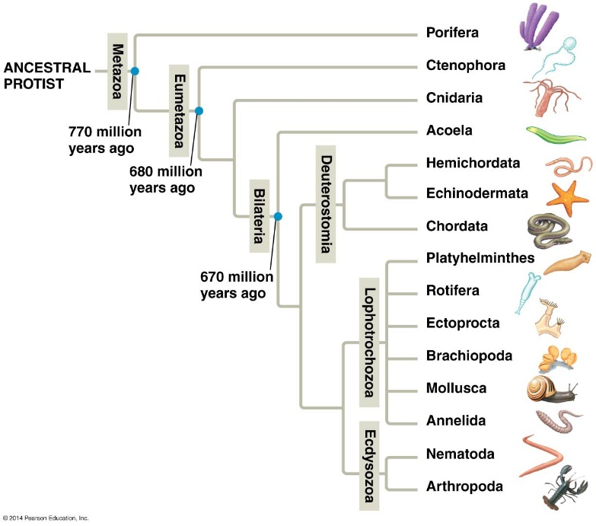
Cladogram of animals

Slide 3
Several Evolutionary Events:
Eumetazoa (Tissues)
Bilateria (Bilateral Organisms)
Deuterostomia (Blastopore becomes Anus).
Lophotrochozoa (Lophophorate Phyla and Trochophore Larva)
Ecydscozoa (Goes through ecdysis).

Slide 4
Phylum: Mollusca
Most are marine (some are freshwater or terrestrial)
Most are protected by a shell (calcium carbonate)
Most contain a radula
Most have an OPEN circulatory system.

Slide 5
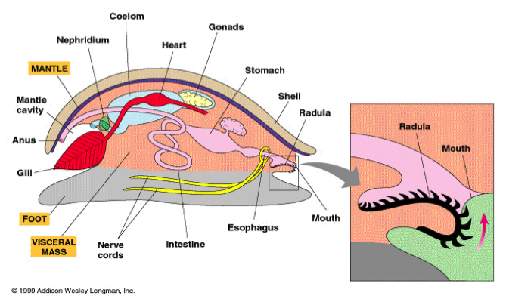
Foot
Basic Body Parts of the HAM: 1) _____________
2)______________
3)______________
4)______________
Mantle
Visceral Mass

Slide 6
Phylum Mollusca
Class: Monoplacophora (Neopilina)
Class: ______________ (Chitons)
Class: Gastropoda (Snails, Slugs)
Class: _______________ (Tooth or Tusk Shells)
Class: Bivalvia (Clams, Mussels, Oysters, scallops)
Class: _______________ (Squids, Octopuses)
Scaphopoda
Cephalopoda

Slide 7
Class: Monoplacophora
Single shelled
Segmented
Deep Marine
Reduced head
Foot for locomotion
Radula present

Slide 8
Class: ___________
Polyplacophora
Marine
Shell with eight overlapping plates
Foot used for locomotion
Head reduced
Radula present

Slide 9
Class: Gastropoda

Slide 10
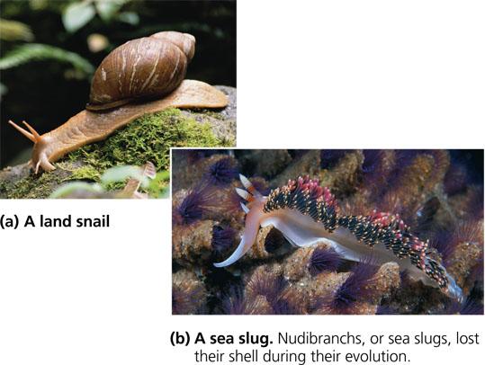
Class: Gastropoda
Marine, Freshwater, and Terrestrial
Asymmetrical due to _________
Shell coiled (reduced or absent in some)
(dextral vs. sinistral)
Foot for locomotion
Radula present

Slide 11
Class: Scaphopoda
Benthic marine
Filter feeders
Foot used to burrow into sand
_________ used to move food to gizzard

Slide 12
Class: Bivalvia
Marine and Freshwater
Flattened shell with two valves
Head reduced
Filter feeders (siphons)
No _________
radula

Slide 13
Class: Cephalopoda
All Marine
Head surrounded by tentacles
Shell external, internal or absent
Mouth with radula
Locomotion by siphon (made from mantle)
________ Circulatory System

Slide 14
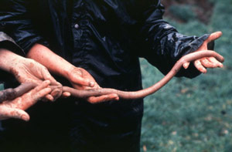
Phylum: Annelida
Repeated Segments
Specialized Segments
Connections
Giant Gippsland Earthworm, Australia
Average 6 feet! (up to 15!)

Slide 15
Classification
Class: ______________
(Earthworms)
Class: Polychaeta
(Marine worms)
Class: Hirudinea
(Leeches)

Slide 16
Class: Oligochaeta
Reduced head
No _________
A few setae per segment

Slide 17
Class: Polychaeta
Well developed head
Parapodia with setae
Tube-dwelling and free-living

Slide 18
Class: Hirudinea
Body usually flattened
Reduced segments and coelom
Setae absent
Suckers at both ends
Parasites, predators and scavengers

Slide 19
Animal Circulation and Gas Exchange

Slide 20
Circulation In Animals
__________ Circulatory Systems
Arthropoda, Mollusca
Hemolymph (no blood or interstitial fluid)
__________ Circulatory Systems
mollusca, nematoda, annelida, vertebrates
blood
interstitial fluid

Slide 21
Cells

Slide 22
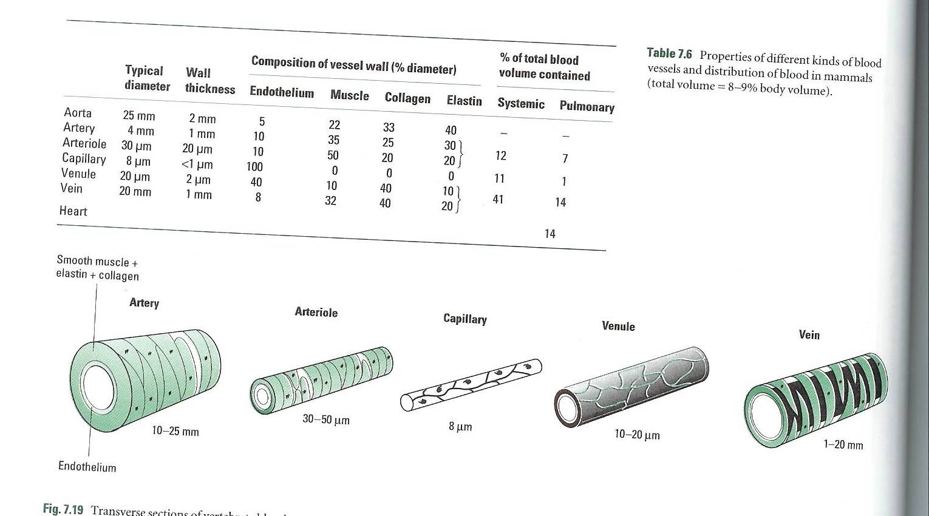
Cardiovascular System
Heart
atria & ventricles
Arteries
Arterioles
Capillaries
Venules
Veins

Slide 23
Phylum: ______________
Walking worm
Was thought to be link between annelids and arthropods
Unjointed appendages but segmented

Slide 24
Phylum: Arthropoda
Hard exoskeleton, segmented
Segments carry paired appendages
Open circulatory system
Nervous system similar to annelids
Contains 80% of all identified species (Currently about 1 million species)

Slide 25
Arthropod Diversity
Versatile exoskeleton
Segmentation and appendages
Tracheae
Highly developed sense organs
Complex behavior patterns
_____________
Metamorphosis

Slide 26
Arthropod Classification
Subphylum: Trilobita
Subphylum: Cheliceraformes
Class: Merostomata (Horseshoe crabs)
Class: Pycnogonida (Sea Spiders)
Class: ____________ (Scorpions, Spiders, Ticks, Mites)
Arachnida

Slide 27
Arthropod Classification
Subphylum: Crustacea
Class: Crustacea (Lobster, Crabs, Shrimp)
Subphylum: Myriapoda (Uniramia)
Class: Chilopoda (Centipedes)
Class: Diplopoda (Millipedes)
Subphylum: Hexapoda
Class: Insecta (Insects)

Slide 28
Subphylum: ________
All extinct (Permian era - 250 mya)
Segmented without specialization
Paired appendages

Slide 29
Subphylum: Cheliceraformes
Six pairs of appendages
one pair of _____________
one pair of pedipalps (not in horseshoe crabs)
four pair of walking legs
No mandibles
No antennae
Chelicerae

Slide 30
Class: Merostomata
Six
_____ pairs of appendages
one pair of chelicerae
five pair of walking legs
Unchanged since the triassic period
Shallow coastal waters
Larvae similar to trilobites

Slide 31
Class: Pyconogonida
Called Sea spiders (not true spider)
May have extra legs (duplicate segments)
Polar oceans

Slide 32
Class: Arachnida

Slide 33
Class: Arachnida
Scorpions are the first terrestrial invertebrates
pedipalps modified as pinchers
tail modified with stinger
Ticks and Mites are parasitic
Spiders contain modified _________
used as fangs to inject poison
produce silk used for webs, eggs, escape, courtship
Chelicerae

Slide 34
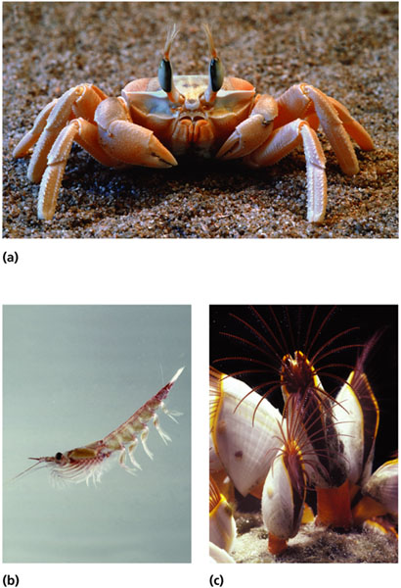
Subphylum: Crustacea

Slide 35
Subphylum: Crustacea
antennae
Contain two pair of __________
Each appendage is __________ (two main branches)
Mandibles
Body of two or three parts
Mostly marine
biramous

Slide 36
Subphylum: Myriapoda

Slide 37
Subphylum: Myriapoda (Uniramia)
Contain one pair of antennae
Each appendage is __________ (one main branch)
Mandibles
uniramous

Slide 38
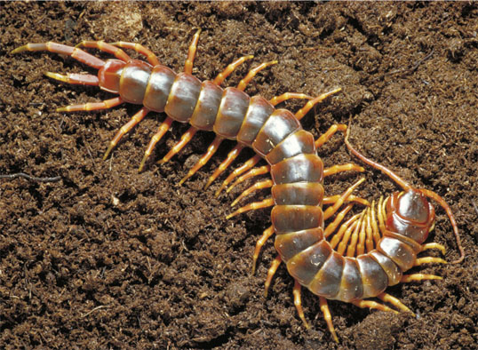
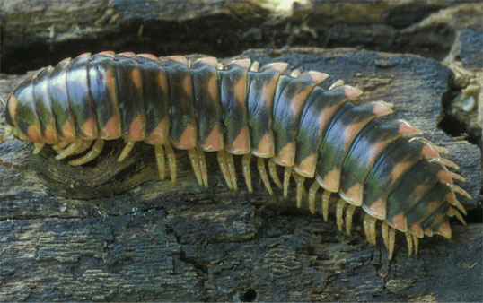
Classes: Chilopoda & Diplopoda
____________
Centipedes
____ pair of jointed legs per segment
poison claws
predators
___________
Millipedes
____ pair of jointed legs per segment (fused)
herbivores

Slide 39
Subphylum: Hexapoda Class: Insecta
Most diverse of all arthropods
May have been the cause of angiosperm diversity
Metamorphosis
complete
incomplete

Slide 40
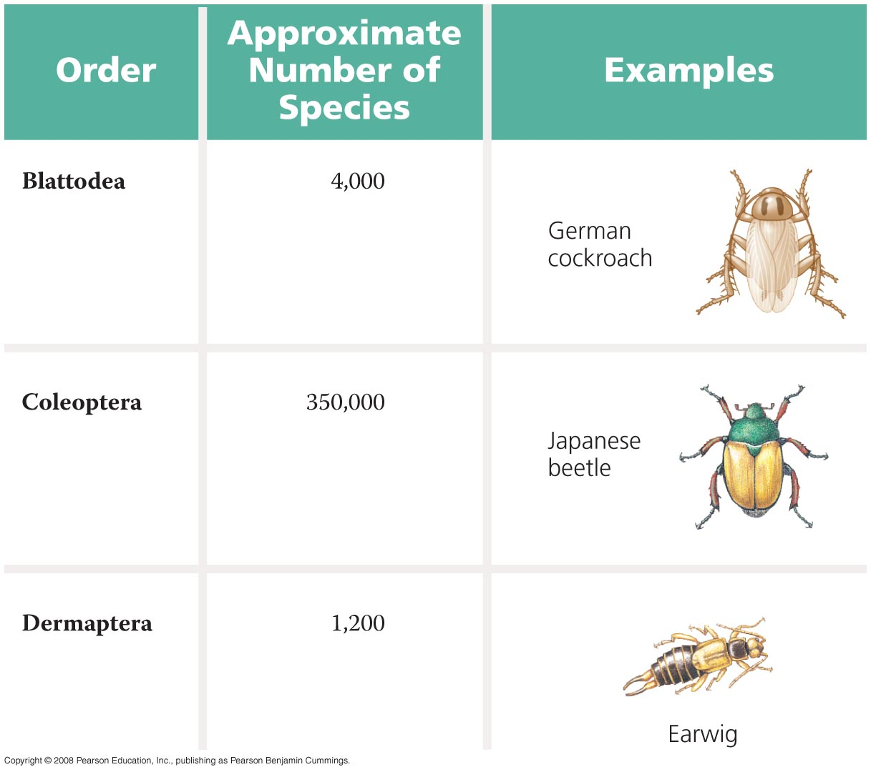
Fig. 33-37a
2 pairs of wings; front thickened elytra
Beetles

Slide 41
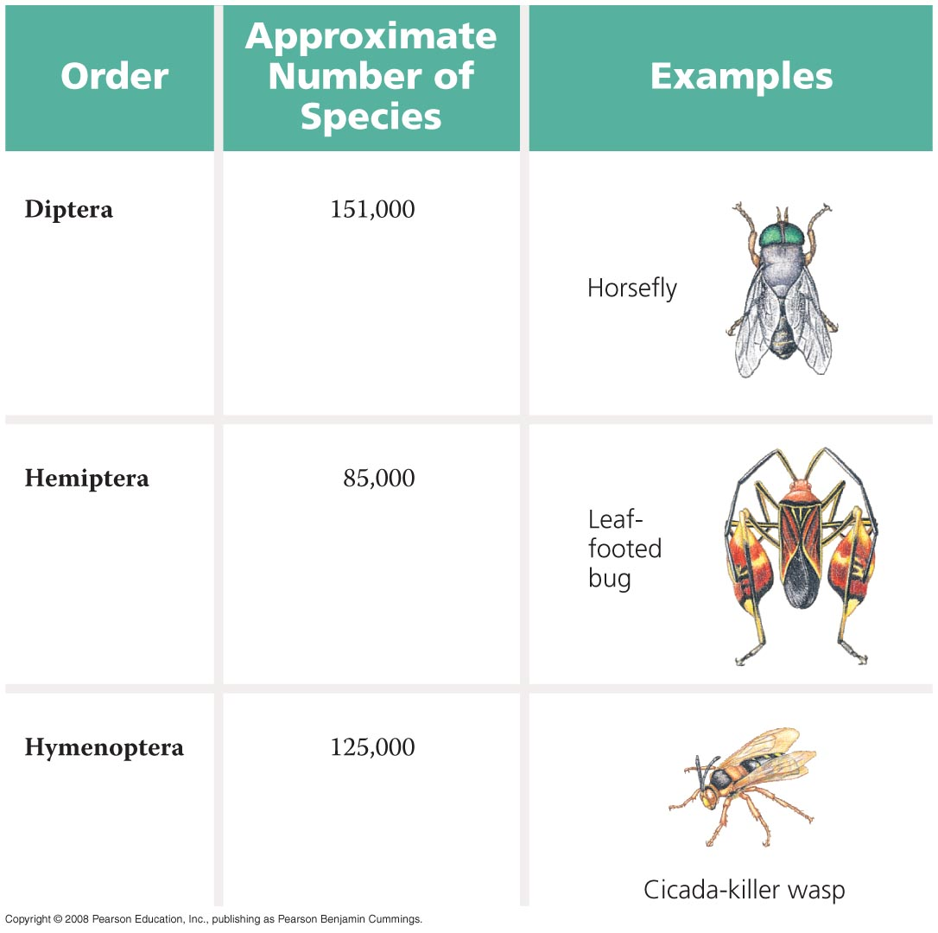
Fig. 33-37b
1 pair of wings; back form knobs called halteres
Flies
Two pairs of wings, ½ have hard outer shell, sucking mouth parts
True Bug
Winged/less 2 pairs membrane wings; thin waist
Bees, Wasps, & Ants

Slide 42
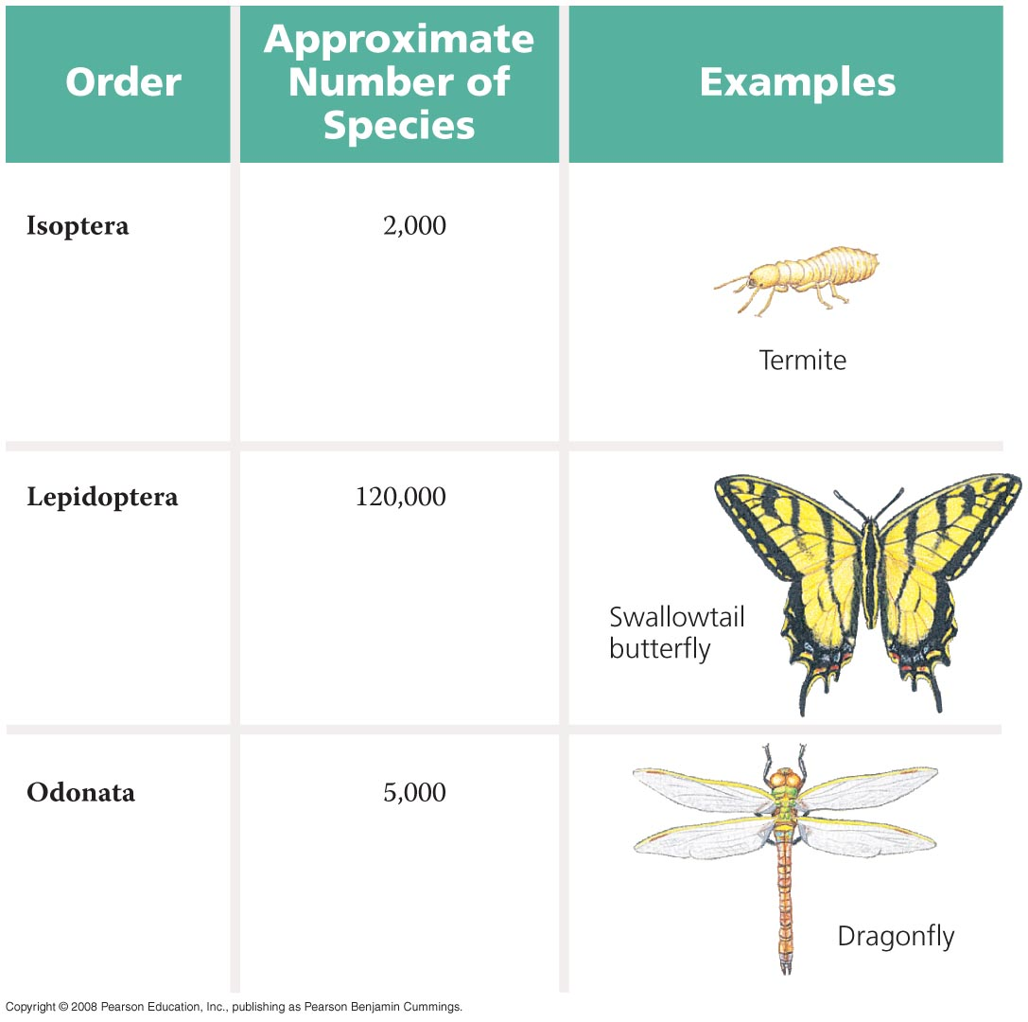
Fig. 33-37c
Two wings covered with scales
Butterflies & moths
Two membranous wings; large compound eyes. Long abdomen
Dragonflies & Damselflies

Slide 43
Phylum: Echinodermata
______________
radial and indeterminate cleavage
Enterocoelous
anus from blastopore

Slide 44
Phylum: Echinodermata
Radial Symmetry
_________________________
Ambulacral groove
Madreporite
All marine
Water Vascular System

Slide 45
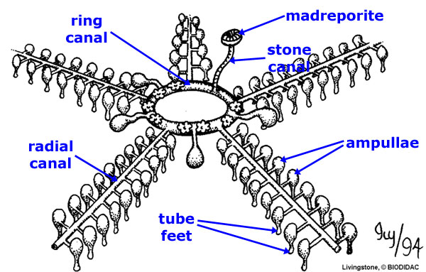
Water Vascular System
___________
Stone Canal
Ring Canal
Radial Canal
Lateral Canal
Ampulla
Tube Feet

Slide 46
Classification
Class: Asteroidea (Seastars)
Class: Opiuroidea (Brittlestars)
Class: Echinoidea (Sea Urchins, Sand Dollars)
Class: Crinoidea (Sea Lilies)
Class: Holothuroidea (Sea Cucumbers)

Slide 47
Class: Asteroidea
Five arms radiating from a central disc
______ ambulacral groove
Madreporite on the aboral side
Contain pedicellariae and papulae
Open

Slide 48
Class: Ophiuroidea
Five thin arms radiating from a central disc
______ ambulacral grooves
Madreporite on the oral side
No suckers on tube feet, pedicellariae or papulae
Closed

Slide 49
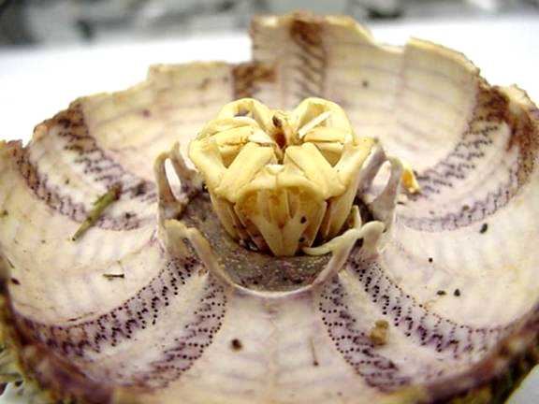
Class: Echinoidea
No arms but have five rows of tube feets
Contain spines
Closed ambulacral grooves
Madreporite on the _______ side
Contain pedicellariae and ________
Aristotle’s lantern
aboral
Papulae

Slide 50
Class: Crinoidea
Attached to substrate with many branched arms
Open ambulacral grooves
No __________
No pedicellariae or papulae
Madreporite

Slide 51
Class: Holothuroidea
Soft bodied
Ambulacral areas with tube feet
________ Madreporite
No pedicellariae or papulae
Closed ambulacral grooves
Internal

