Slide 1
4b. Innate (nonspecific) Immunity

Slide 2
Chapter 16: Innate (nonspecific) Immunity
Some terms:
Susceptibility: Lack of immunity to a disease.
Immunity: Ability to ward off disease.
immunity: Defenses against any pathogen.
  Does not involve specific recognition of a microbe
  No memory response
immunity
  Specific response to a specific microbe once a microbe has breached the innate immunity defenses!
  Slower to respond but develops memory
Innate
Adaptive

Slide 3
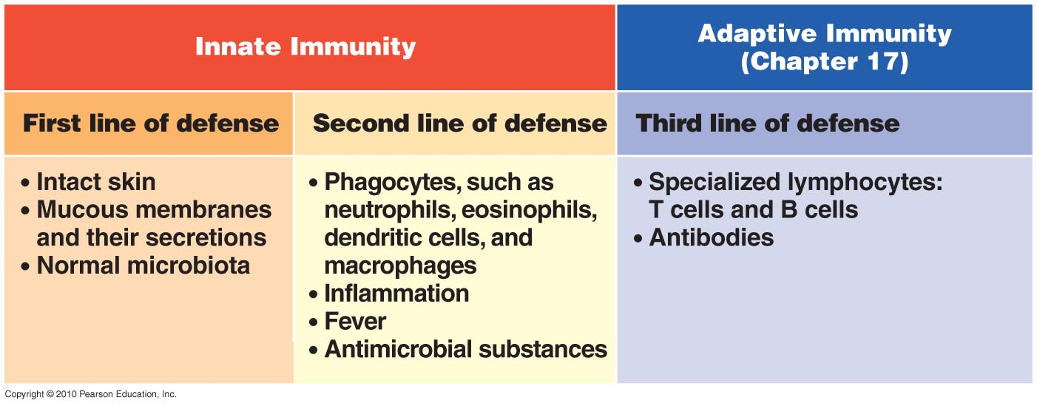
An overview of the body’s defenses
Figure 16.1
4a
4b

Slide 4
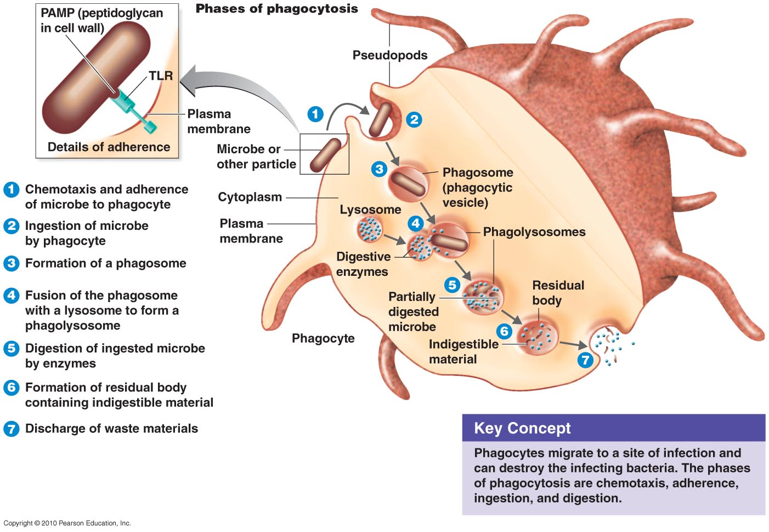
The Concept of Innate Immunity
On Your Cells!
Host Toll-like receptors (TLRs) attach to
Pathogen-associated molecular patterns (PAMPs)
TLRs induce cytokines that regulate the intensity and duration of immune responses
On Pathogen!

Slide 5
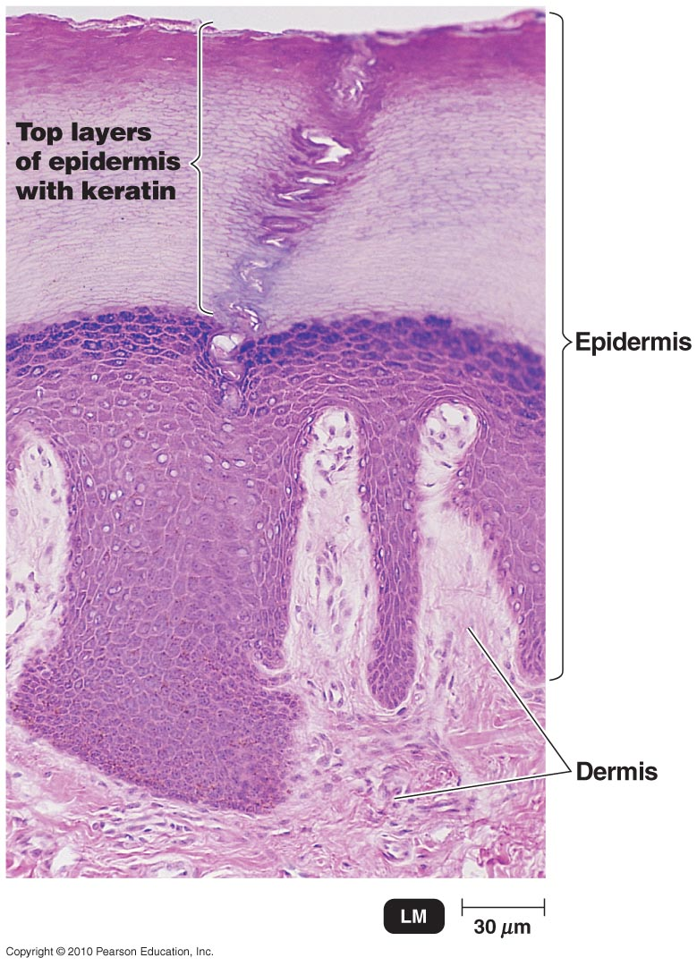
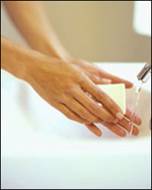
A. Physical barriers (first line of defense)
skin, mucous membranes = prevent entry to most pathogens
Epidermis consists of tightly packed cells with
  Keratin, a protective protein

Slide 6
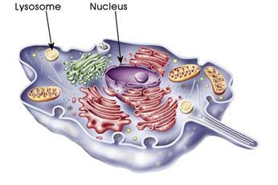
B. Lysozyme
enzyme in tears, sweat, saliva, etc that dissolves bacterial cell walls (digests peptidoglycan)

Slide 7
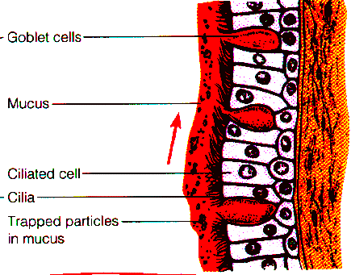
C. Respiratory cilia
carry pathogens out of lungs

Slide 8
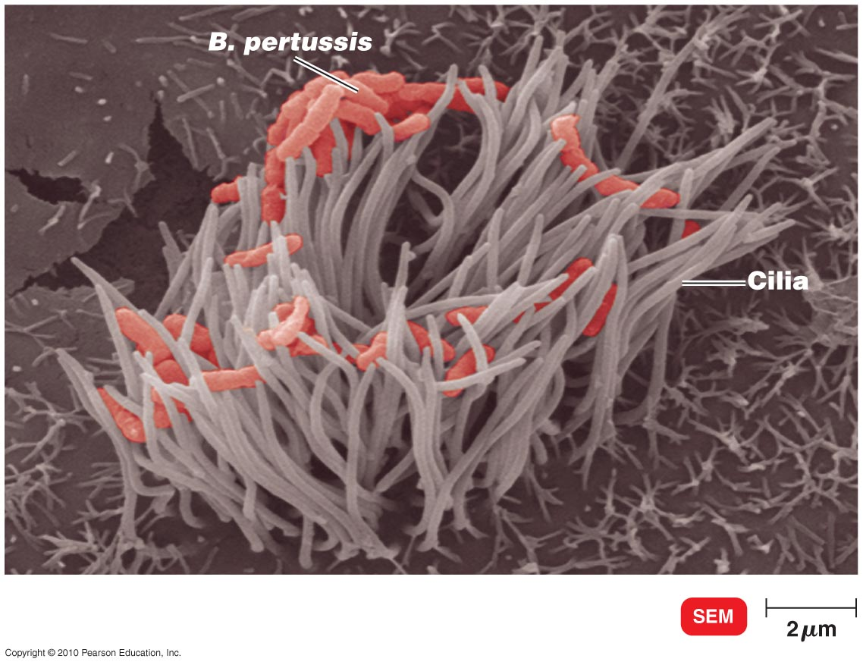
Respiratory cilia

Slide 9
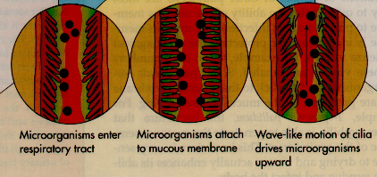

Slide 10
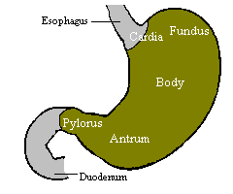
D. Stomach acid
HCl at pH 1-2
kills many, but not all pathogens

Slide 11
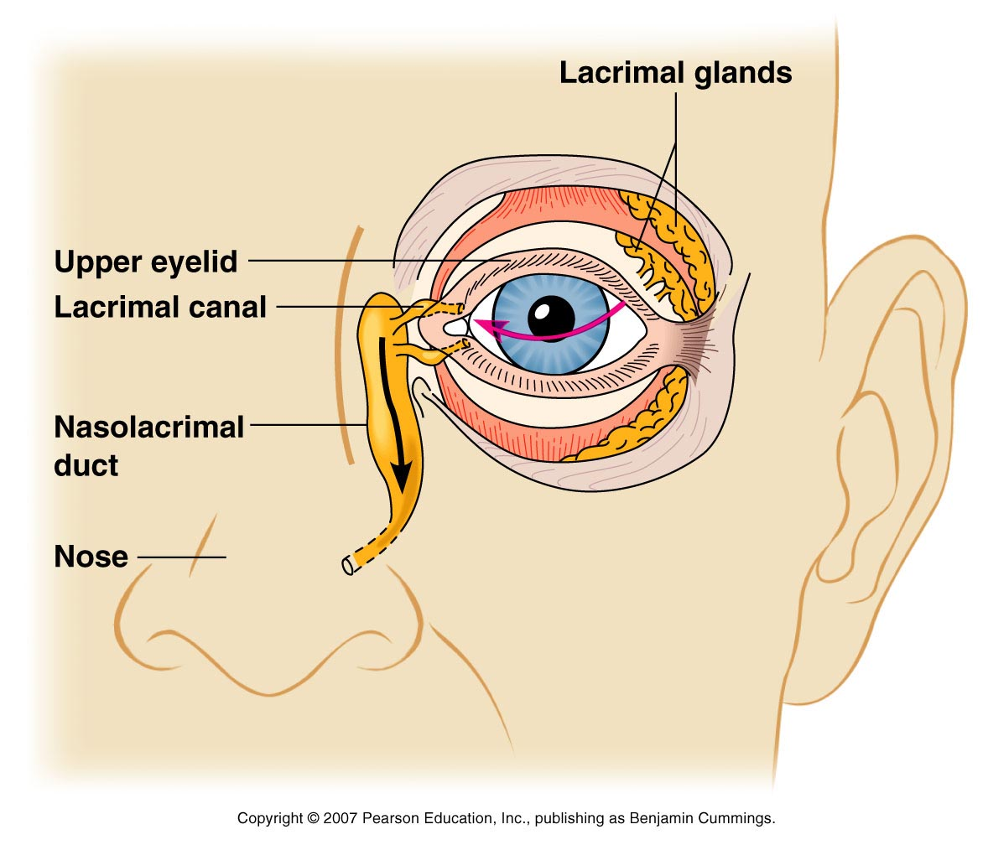
Physical factors
Mucous membranes
Ciliary escalator:
Microbes trapped in mucus
are transported away from
the lungs.
Lacrimal apparatus:
Washes eye.
Saliva: Washes microbes off.
Urine: Flows out.
Vaginal secretions: Flow out.

Slide 12
Chemical Factors
Fungistatic fatty acid in sebum
Low pH (3–5) of skin
Lysozyme in perspiration, tears, saliva, and urine
Low pH (1.2–3.0) of gastric juice
Low pH (3–5) of vaginal secretions

Slide 13
Normal Microbiota and Innate Immunity
Microbial antagonism/competitive exclusion: Normal microbiota compete with pathogens or alter the environment
Commensal microbiota: One organism (microbe) benefits and the other (host) is unharmed
  May be opportunistic pathogens

Slide 14
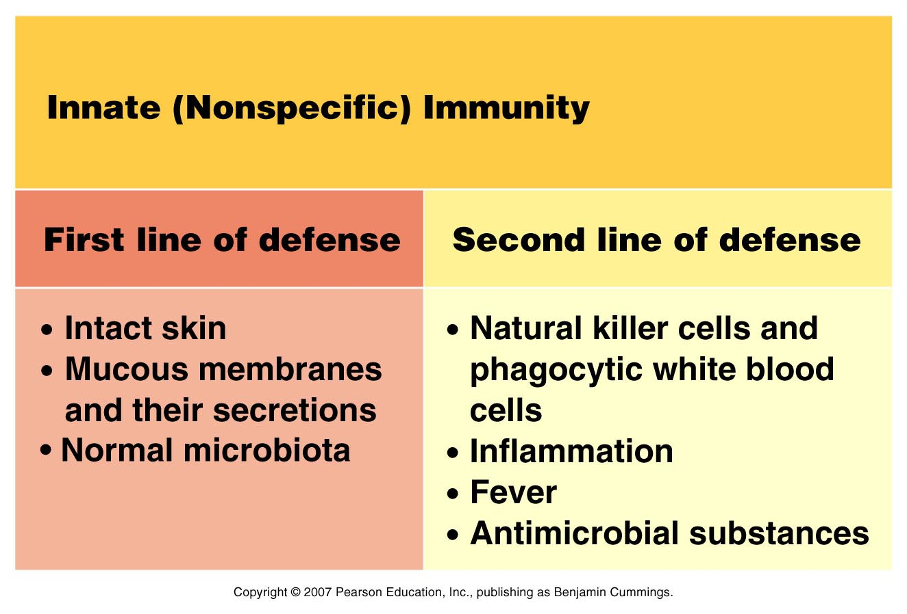

Slide 15
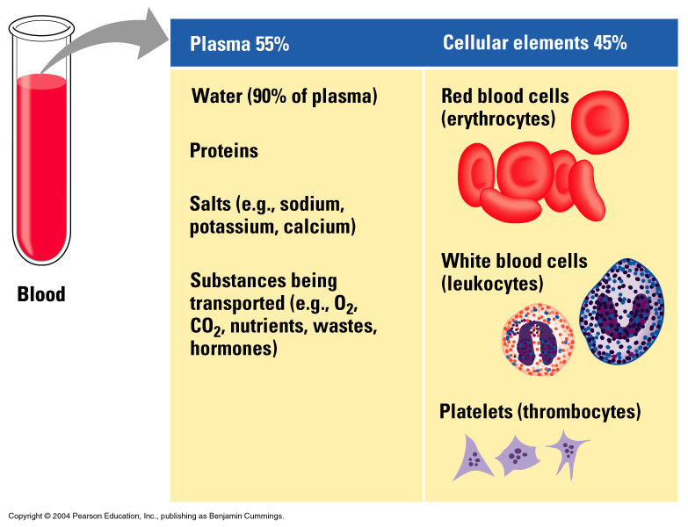
Mammalian Blood Composition
Plasma
Cellular
________ (55%)
  Water
  Ions
  Plasma Proteins
  Nutrients
  Waste
  Gases
  Hormones
_______ Elements (45%)
  Erythrocytes
  Leukocytes
  Thrombocytes

Slide 16
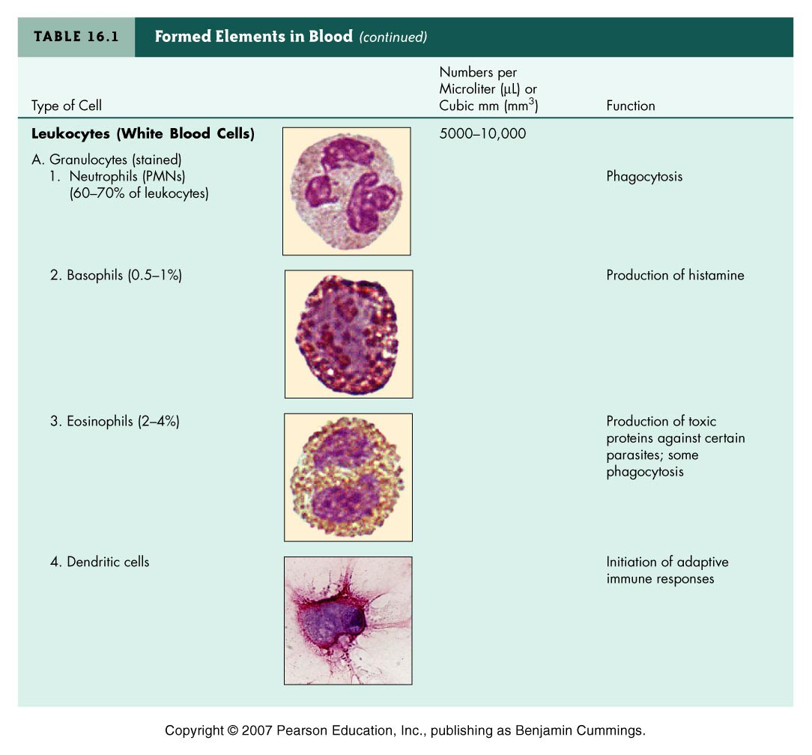
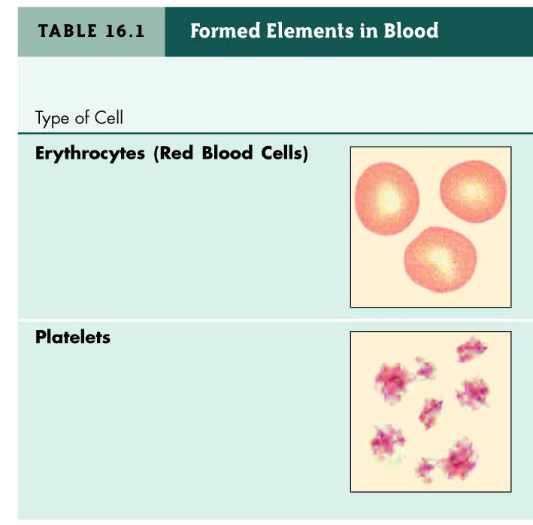
Formed Elements in Blood

Slide 17
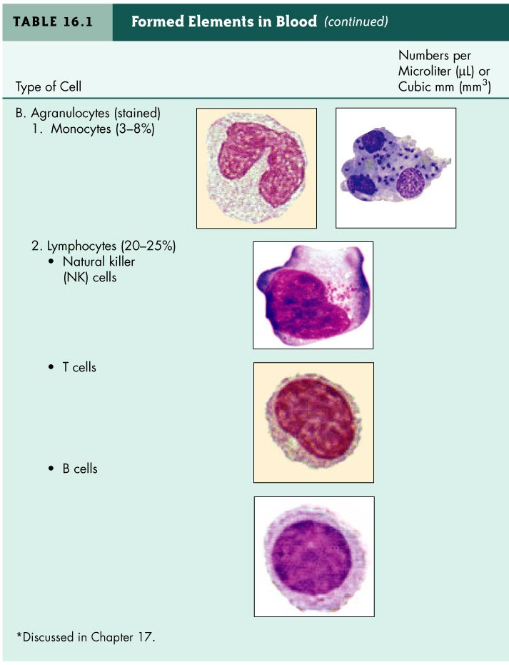

Slide 18
Differential White Cell Count
Percentage of each type of white cell in a sample of 100 white blood cells
Neutrophils | 60–70%
Basophils | 0.5–1%
Eosinophils | 2–4%
Monocytes | 3–8%
Lymphocytes | 20–25%

Slide 19
White Blood Cells
Neutrophils: Phagocytic (most abundant)
Basophils: Produce histamine
Eosinophils: Toxic to parasites and some phagocytosis (worm infections)
Dendritic cells: Initiate adaptive immune response
Monocytes: Phagocytic as mature macrophages
  Fixed macrophages in lungs, liver, and bronchi
  Wandering macrophages roam tissues.
Lymphocytes: Involved in specific immunity.

Slide 20
Figure 16.7

Slide 21
Microbial Evasion of Phagocytosis
Inhibit adherence: M protein, capsules | Streptococcus pyogenes, S. pneumoniae
Kill phagocytes: Leukocidins | Staphylococcus aureus
Lyse phagocytes: Membrane attack complex | Listeria monocytogenes
Escape phagosome | Shigella, Rickettsia
Prevent phagosome-lysosome fusion | HIV, Mycobacterium tuberculosis
Survive in phagolysosome | Coxiella burnettii
Notes:
Stopped on slide 22

Slide 22
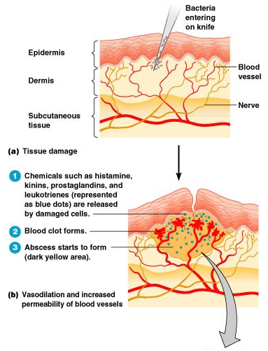
Inflammation

Slide 23
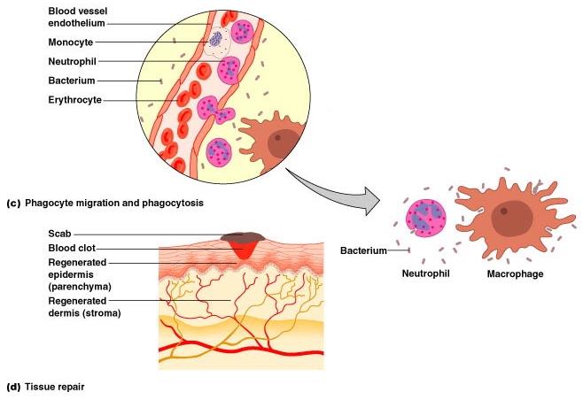
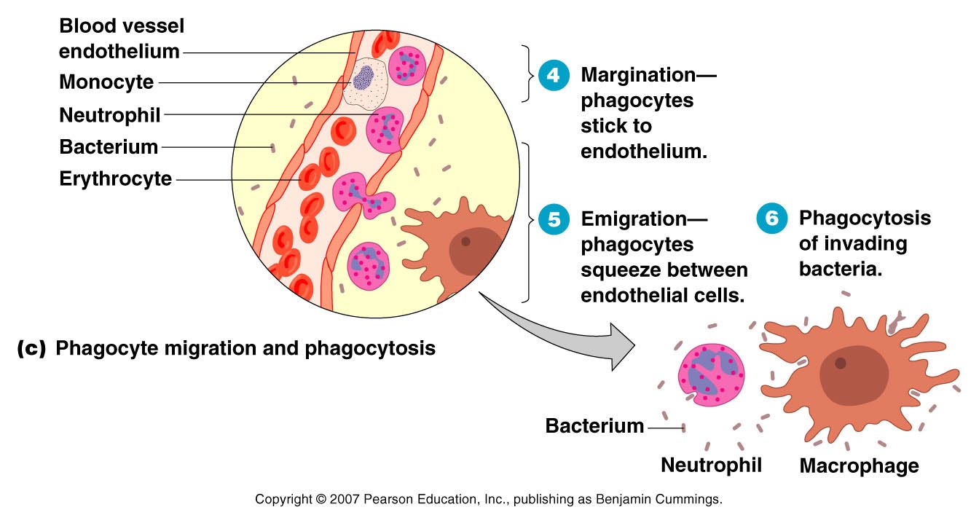
Inflammation

Slide 24
Inflammation
Redness
Pain
Heat
Swelling (edema)
Acute-phase proteins activated (complement, cytokine, and kinins)
Vasodilation (histamine, kinins, prostaglandins, and leukotrienes)
Margination and emigration of WBCs
Tissue repair

Slide 25
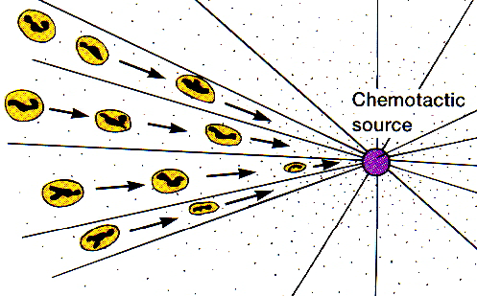
chemotaxis: phagocytes attracted to pathogen

Slide 26
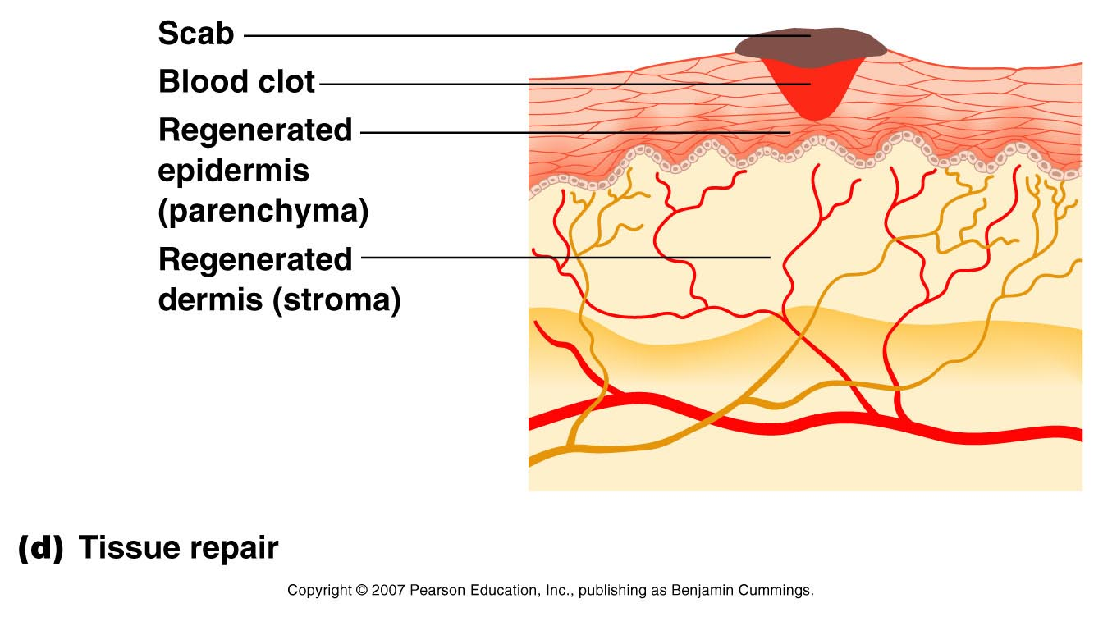
Tissue Repair

Slide 28
Fever
Abnormally high body temperature
Hypothalamus normally set at 37°C
Gram-negative endotoxin cause phagocytes to release interleukin–1 (IL–1)
Hypothalamus releases prostaglandins that reset the hypothalamus to a high temperature
Body increases rate of metabolism and shivering which raise temperature
Vasodilation and sweating: Body temperature falls (crisis)

Slide 29
Fever
A moderate fever is beneficial to host defenses
speeds up body defenses; slows down growth of pathogens
Fever producing pyrogens are produced by activated macrophages as well as bacteria, viruses, and other microbes
  Stimulate hypothalamus to raise body temp.
  Thus cell metabolism increases and blood vessels constrict keeping heat within (cold skin/chills with fever)
  But, above 105⁰ F, convulsions and death may result
    Infants >100⁰F and older children >102⁰F need medical attention!

Slide 30
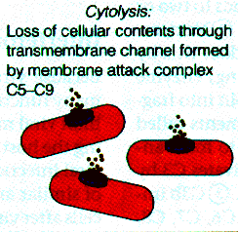
Antimicrobial substances: The Complement System
Complement (complement system): a series of over 30 blood proteins (produced by the liver) that circulate in the bloodstream and sequentially bond together to causes lysis of pathogens, inflammation and help phagocytosis
“complements” the cells of the immune system in destroying microbes
can be a specific or
nonspecific defense

Slide 31
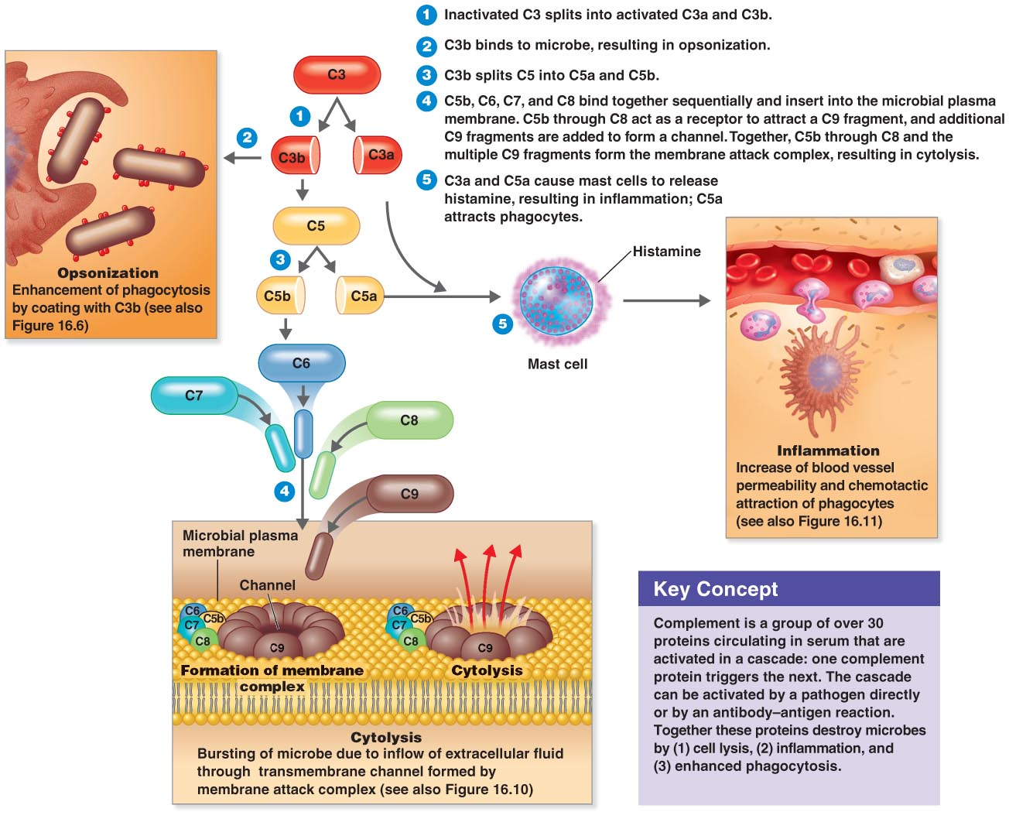
Compliment Sysmtem

Slide 32
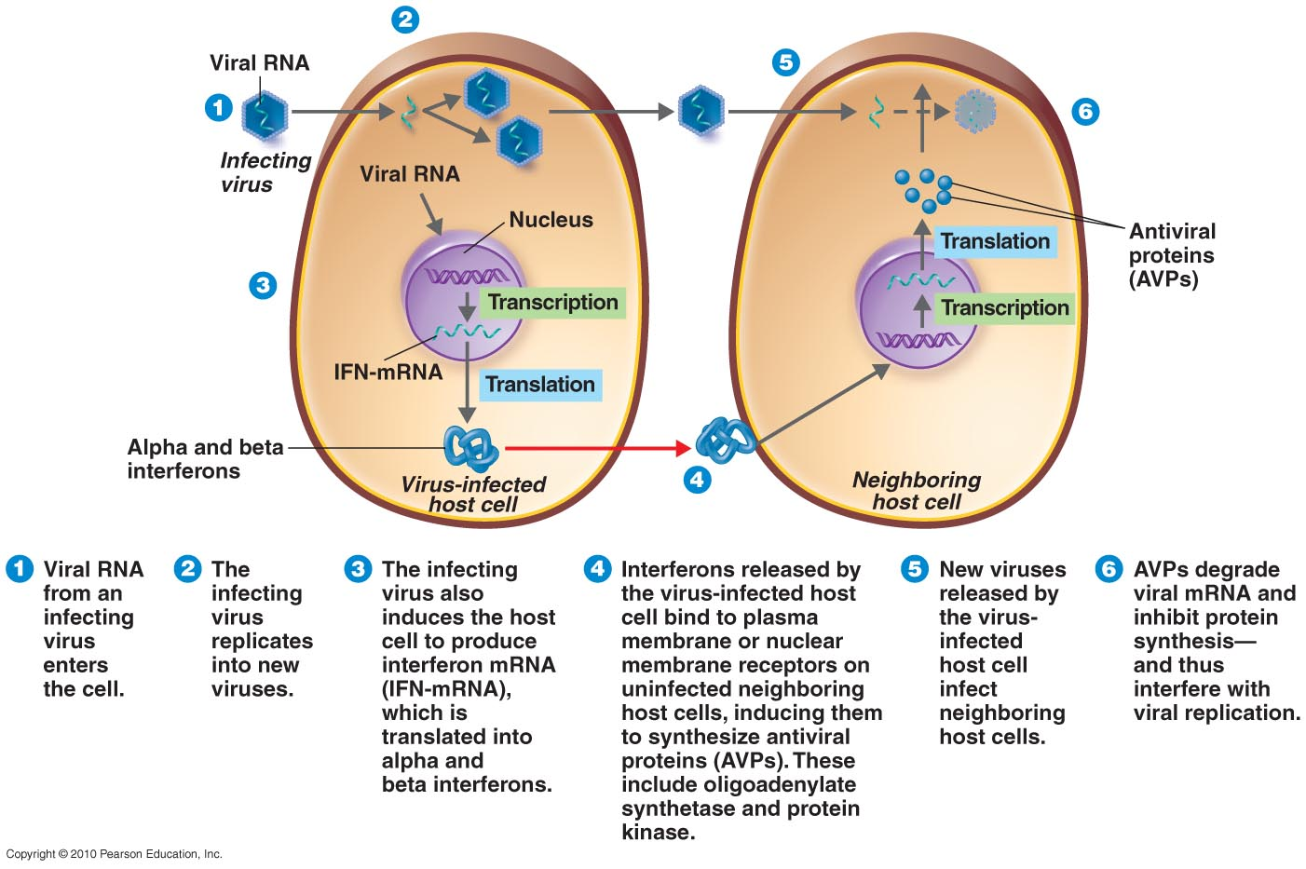
Interferons (IFNs)
messenger proteins produced by virus-infected cells
tell surrounding cells to produce anti-viral protein
also produced by genetic engineered microorganisms for injection as antiviral drugs

Slide 33
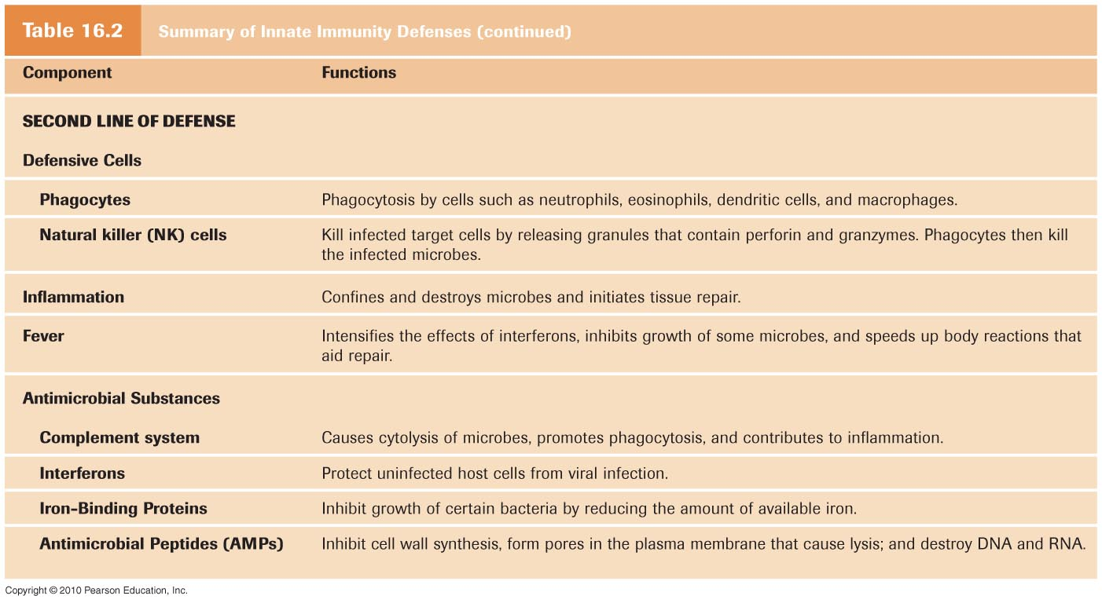
Summary of Second Line of Defense

Slide 34
Stress theory of disease
Hans Selye
A. Stressor: any force that elicits the stress response
  invasion by pathogen
  trauma
  surgery
  emotional conflict
  performance demands
  difficult relationships
  life changes (positive or negative)

Slide 35
B. Stress
the body’s response to any stressor
includes many measurable physiological changes intended to increase resistance to stressors
also called the General Adaptation Syndrome
1. __________: beneficial stress; appropriate in degree and duration; produces optimum physical and mental function and resistance to pathogens
2. __________: harmful stress; excessive in degree and/or duration; impairs physical and mental function; reduces resistance to pathogens
Stress management
Eustress
Distress

