Slide 1
4B – Adaptive Immunity
…the end…☹

Slide 2
Adaptive (specific) Immunity
The general idea:
  body can recognize specific invader and act to destroy that specific invader.
  Adaptive immunity develops during an individual’s lifetime.
Result of processes that are:
  highly specific against one pathogen, often even against one strain of a pathogen
  NOT inherent, innate or inborn, but only developing after exposure to the pathogen

Slide 3
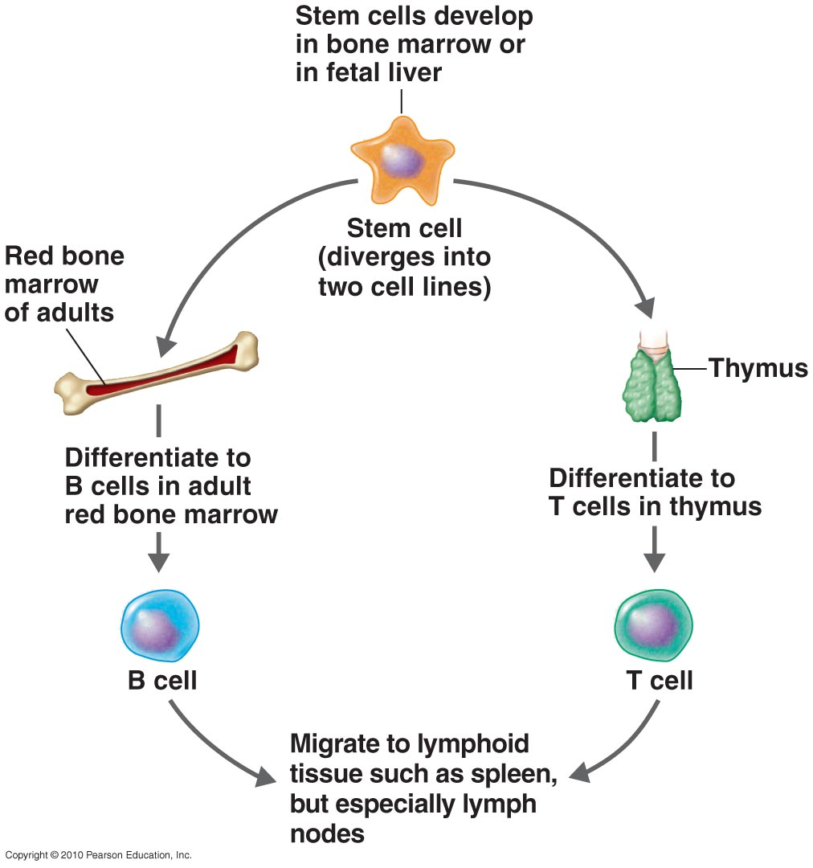
Dual Nature of Adaptive Immunity
B cells and T cells
Figure 17.8

Slide 4
Dual Nature of Adaptive Immunity
T and B cells develop from stem cells in bone marrow
________ immunity(B – cells)
  B cells mature in the bone marrow
  Due to antibodies
________ immunity
  Due to T cells
  T cells mature in the thymus
Humoral
Cellular

Slide 5
_________ (Ag): A substance that causes the body to produce specific antibodies or sensitized T cells.
_________ (Ab): Proteins made in response to an Ag; can combine with that Ag.
Antigen
Antibodies

Slide 6
Antigens (Ag)
Antigens : substances that elicit (stimulate) an immune response
Antigens are usually foreign macromolecules such as proteins or large polysaccharides

Slide 7
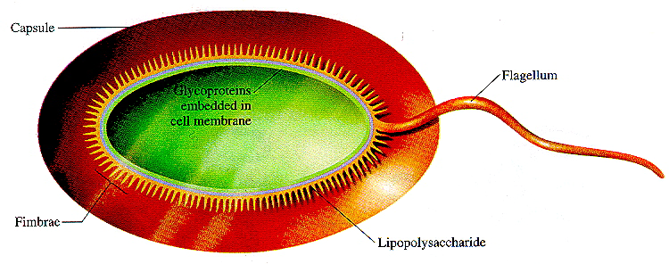
Antigens
antigens occur as:
  parts of pathogens, such as viral protein or bacterial capsule
Capsule
Flagellum
Proteins in
cell membrane
Fimbriae
Lipopolysaccharide

Slide 8
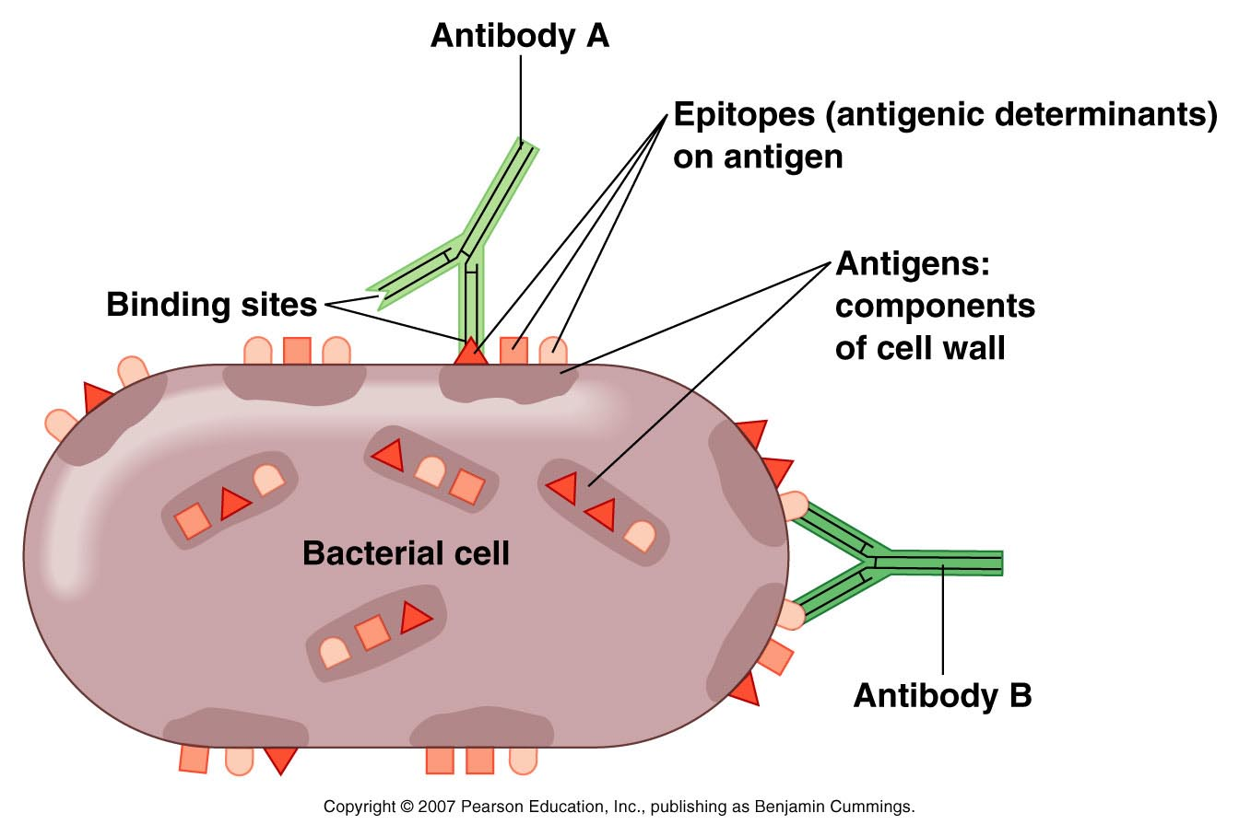
________ (or antigenic determinants): the specific places on the surface of antigens where antibodies bond:
Epitopes

Slide 9
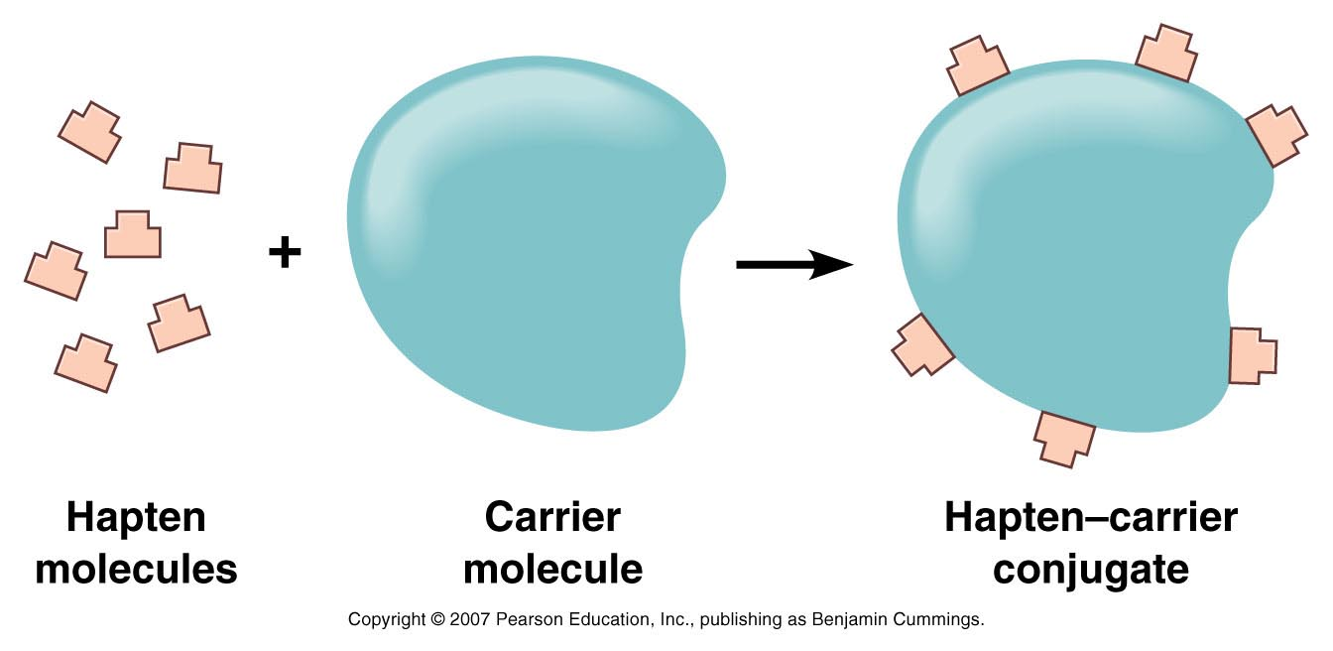
__________: Small molecules not antigenic by themselves, but forming antigens when bonded with blood proteins such as albumin. Become the determinant sites.
Penicillin is a good example of a hapten
Haptens

Slide 10
Antigens occur as:
  products of pathogens, such as bacterial exotoxins
  vaccines (preparations of one or more antigens administered to confer immunity)
    Attenuated whole-agent vaccines
      Living but weakened
    Inactivated whole-agent vaccines
      Microbes killed usually by formalin or phenol
    Toxoids
      Inactivated toxins
    Subunit vaccines
      Use only antigenic fragments
      Recombinant vaccines created (genetically modified yeast against Hepatitis B viral protein coat)

Slide 11
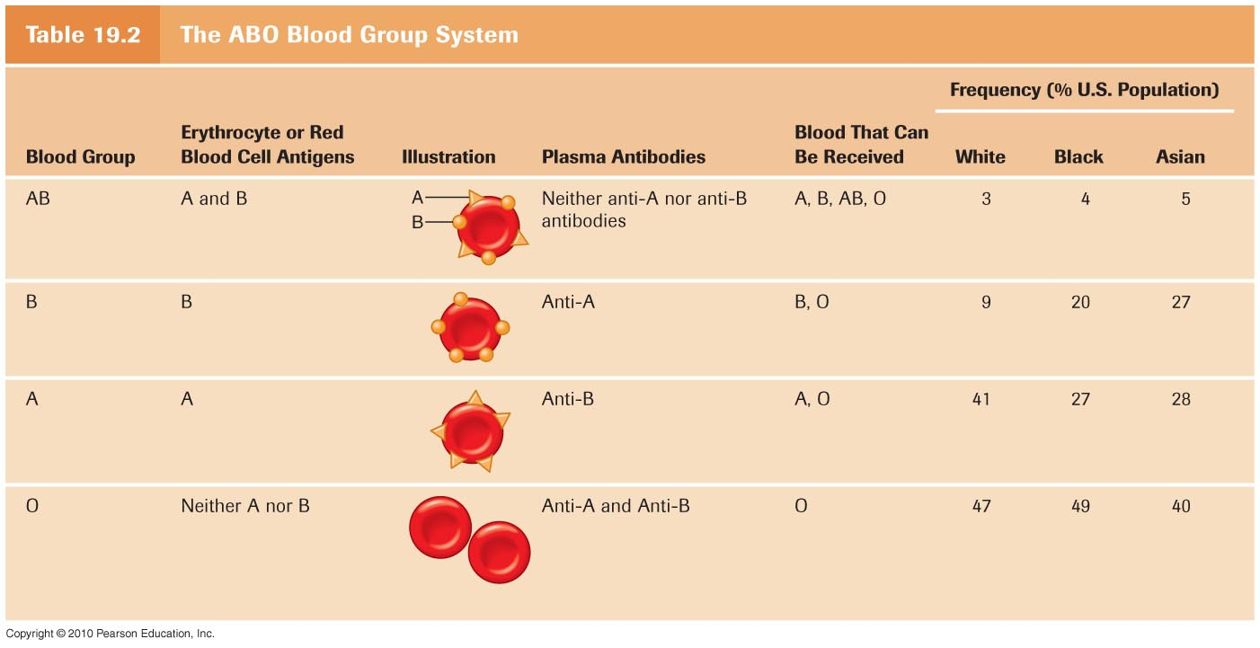
antigens occur as:
  substances causing allergies (allergens)
  chemicals on the surface of all tissues (tissue antigens or MHC —major histocompatibility complex—antigens)
    ABO blood group system as example
      RBC (red blood cell) antigens

Slide 12
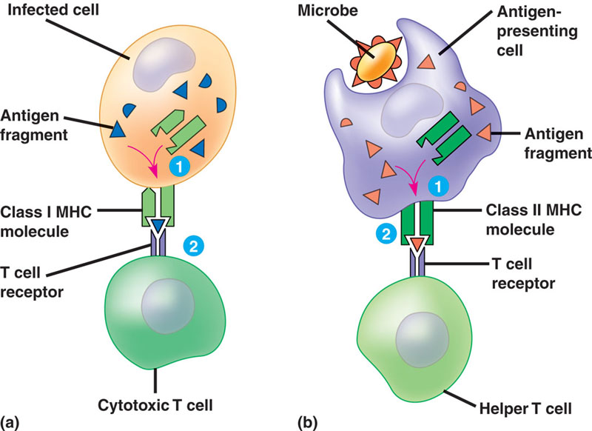
“Self “ antigens and Major Histocompatibility Complex (MHC)
Class 1
__________ MHC molecules
  Found on all nucleated cells
  Activate Natural Killer Cells if missing or changed
__________ MHC molecules
  Work with both Cytotoxic T Cells Helper T cells
  Derived from foreign materials that have been internalized
Class 2

Slide 13
Self-Tolerance
  Body should not make Ab against self.
  Autoimmunity
      Diseases produced by failure in the immune system to recognize and tolerate self-antigens
        Lupus
        Rheumatoid arthritis
        Multiple sclerosis
        See pp. 532-533 (more than 40 autoimmune diseases!)

Slide 14
Development of Immune System
Some immature lymphocytes (80%) are processed by thymus to become _______(T lymphocytes)
Other immature lymphocytes are processed by bone marrow to become _______(B lymphocytes)
T cells produce
Cell Mediated (Cellular) Immunity
B cells produce
Humoral (Antibody-Mediated) Immunity
T cells
B cells

Slide 15
Immune Responses
Humoral Immunity
  Involves _________
  produces antibodies that circulate in the blood, plasma and lymph
  cells do not have to be next to antigen to attack
Cell-mediated Immunity
  Involves __________
  cells must be next to antigens to attack
B cells
T cells

Slide 16
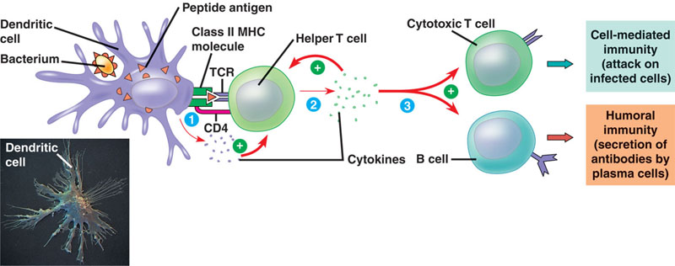
Example (a response to nearly all Antigens)
Helper T cells
  attach to macrophage that has attacked an antigen
    often uses CD4 receptors (binds to class 2 MHC)
  Releases ____________ (a Cytokine)
  activates Cytotoxic T cells and Plasma B cells
An
Antigen Presenting
Cell
interleukin

Slide 17
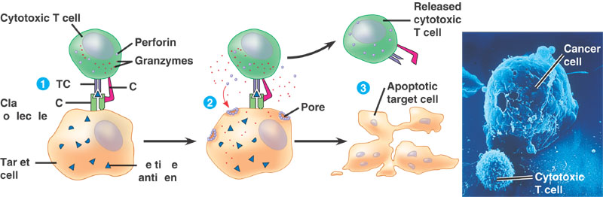
Example of a Cell-mediated Response
Cytotoxic T cells
_____________
  attach to infected cells / Cancer Cells
  Usually uses a CD8 receptor (binds to class 1 MHC)
  perforin (protein) makes a pore in membrane
  ions and water enters pores
  infected cell lyses
Remember, involved with “self”
CD8 Receptor
Class 1 MHC

Slide 18
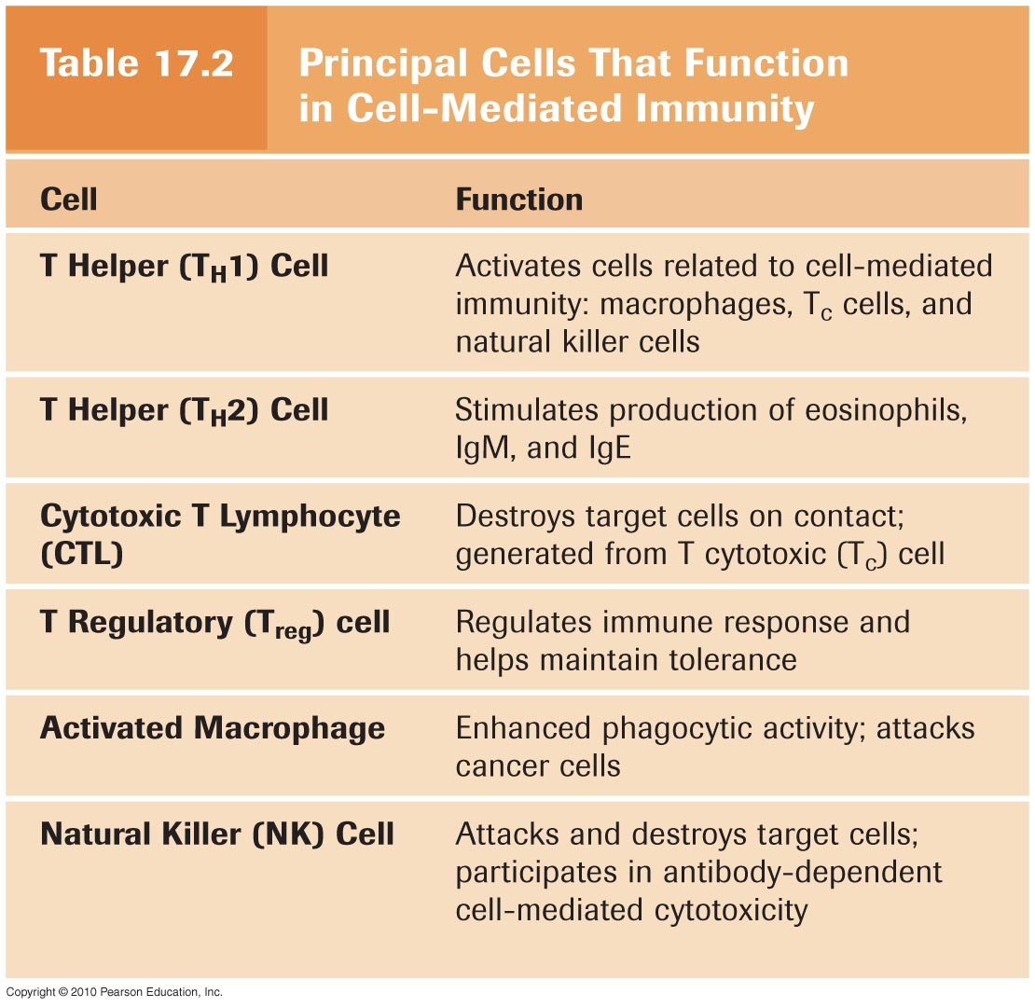
Table
17.2

Slide 19
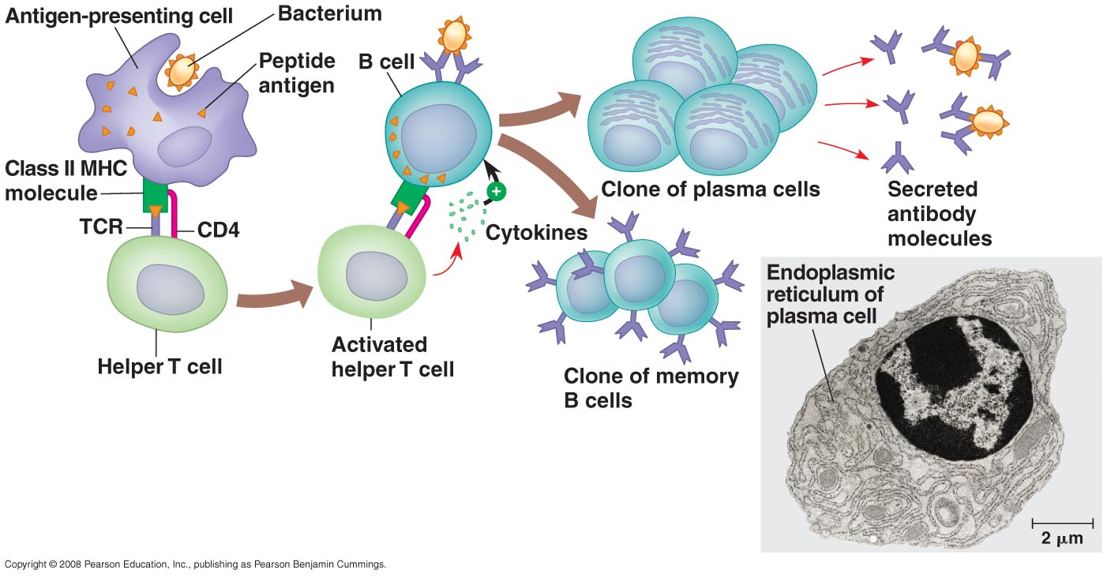
Example of a B-cell (humoral immunity) Response to Extracellular Pathogens
  extracellular pathogens
  Plasma B cells produce antibodies
  Memory B cells live a long time and can help produce other B cells quickly when re-infected by the same antigen

Slide 20
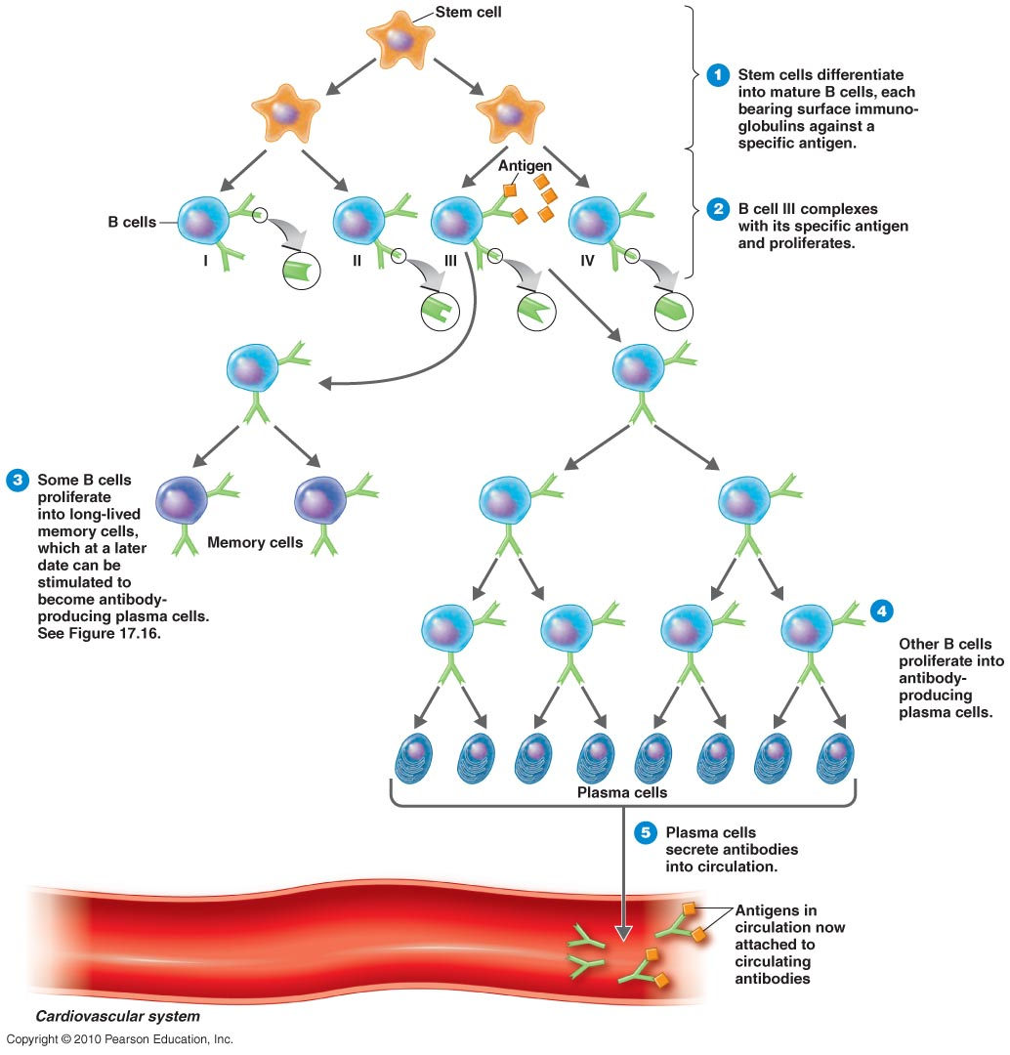
Fig. 17.5
Clonal
selection
and
differentiation
of B cells

Slide 21
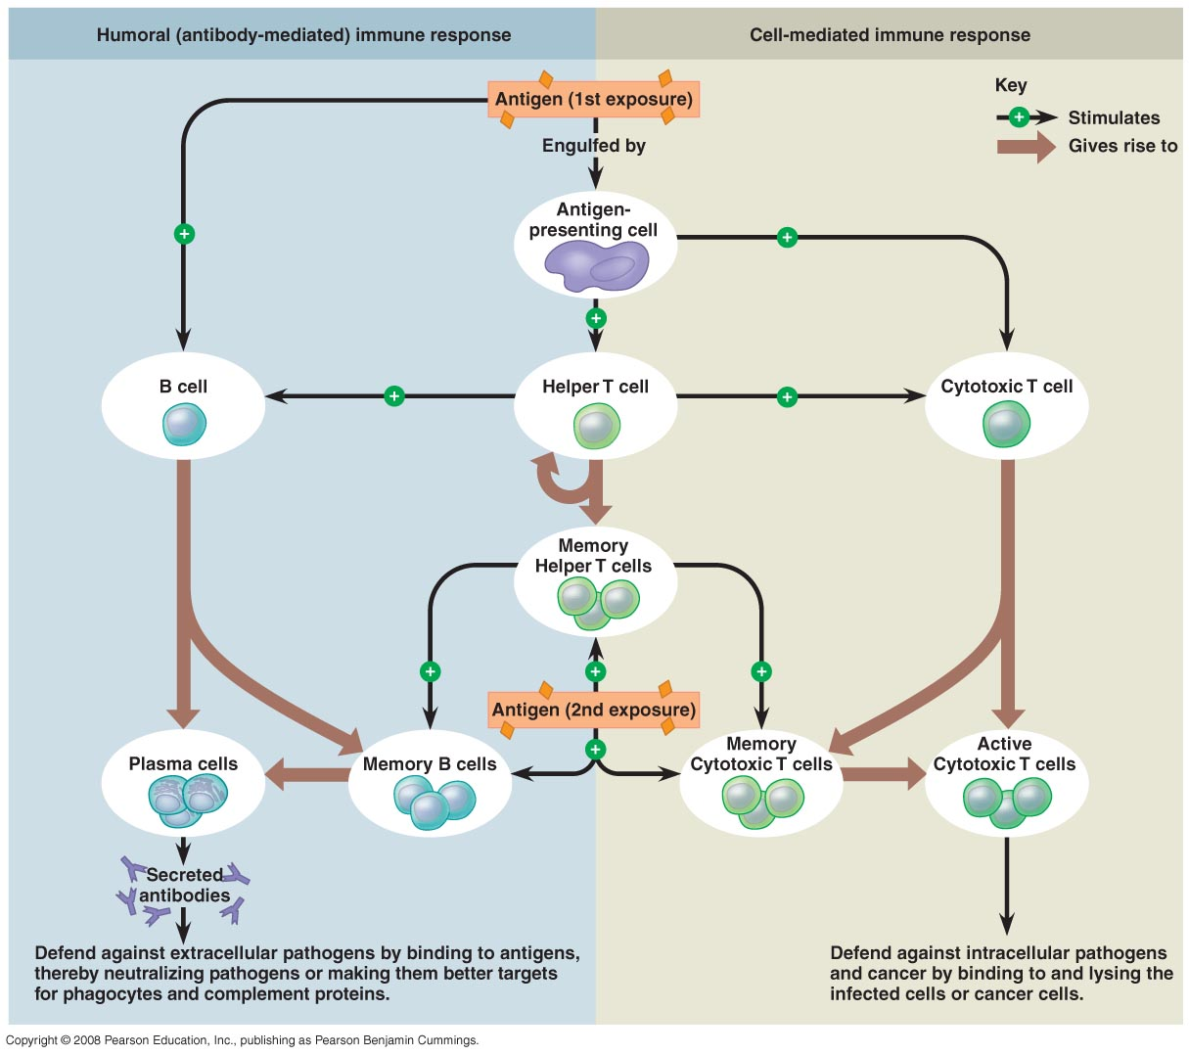

Slide 22
Cytokines
generic term for protein “messenger” chemicals that allow one cell to communicate with another. There are many (more than 200?):
  Interleukins (at least 29 kinds): communicate between white blood cells
  interferons: from virus-infected cells
  histamine: causes inflammation and allergy

Slide 23
Cells Communicate via Cytokines
Cytokine | Representative Activity
Interleukin-1 (IL-1) | Stimulates T_{H} cells in presence of antigens; attracts phagocytes
Interleukin-2 (IL-2) | Proliferation of antigen-stimulated CD4⁺ T helper cells, proliferation and differentiation of B cells; activation of CD8⁺ T cells and NK cells
Interleukin-12 (IL-12) | Inhibits humoral immunity; activates T_{H}1 cellular immunity

Slide 24
Cells Communicate via Cytokines
Cytokine | Representative Activity
Chemokines | Induce the migration of leukocytes
TNF-α | Promotes inflammation
Hematopoietic cytokines | Influence differentiation of blood stem cells
IFN-α and IFN-β | Response to viral infection; interfere with protein synthesis
IFN-γ | Stimulates macrophage activity

Slide 25
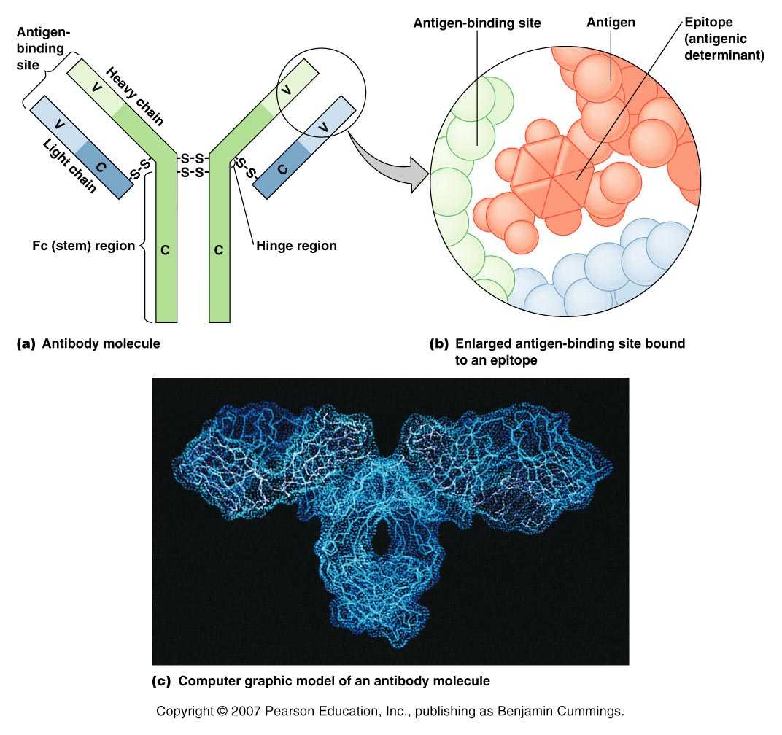
Antibody Structure

Slide 26
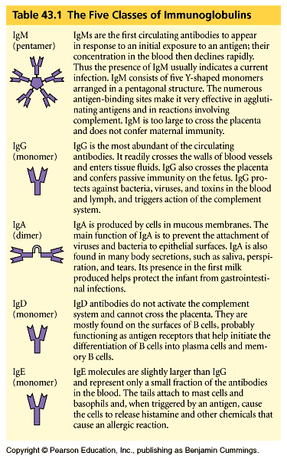
IgM - First to appear, numerous binding sites make them effective at agglutinating antigens.
IgG – Most abundant, crosses placenta
IgA – produced in mucous membranes, prevent virus/bacteria attachment to epithelial cells; present in “first milk” – protects infants from GI infections.
IgD – Mostly found on B cells as antigen receptors
IgE – Involved with allergic reactions; cause release of histamine
Notes:
IgG most abundant cross placenta
IgA found in breast milk

Slide 27
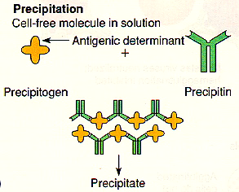
Acquired Immunity: Things Abs can do
1. Precipitation: soluble Ag becomes insoluble, forms precipitate
Essay!

Slide 28
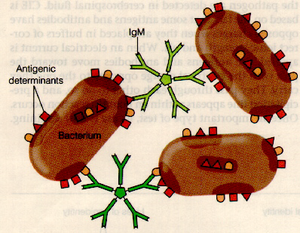
2. Agglutination: particles, such as bacteria, are clumped together

Slide 29
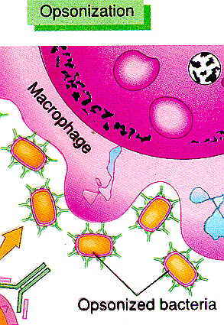
3. Opsonization: pathogens
prepared for phagocytosis

Slide 30
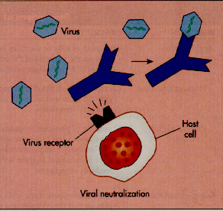
4. Viral neutralization:
Abs bond to virus,
block attachment to
host cell

Slide 31
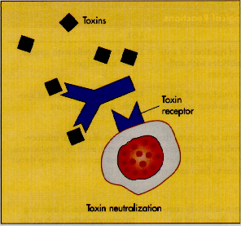
things antibodies can do
5. Toxin neutralization: Abs bond to toxin;
inactivate it (antitoxins: Abs that neutralize toxins)

Slide 32
More terms….
Serology: The study of reactions between antibodies and antigens.
Antiserum: The generic term for serum because it contains Ab.
Globulins: Serum proteins
Immunoglobulins: Antibodies

Slide 33
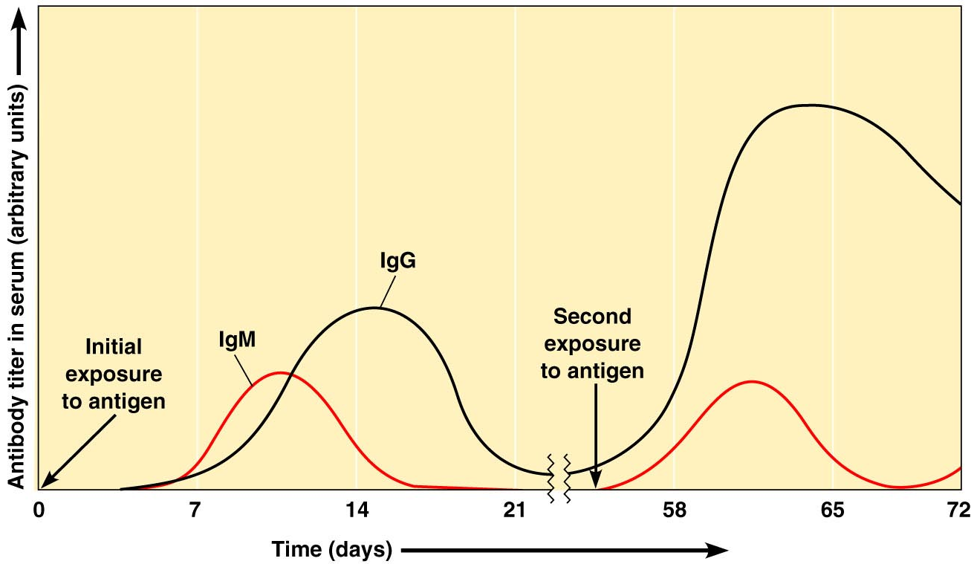
Immunological Memory
_____ = level of antibodies in blood
Figure 17.16
Titer

Slide 34
immune memory
Upon subsequent exposure to same Ag, the immune response is rapid and strong: will prevent infection
  humoral: minutes to hours
  CMI: 1–2 days
Memory is stored in “trained” B or T cells (B or T memory cells) that form clones in lymph nodes and other lymphatic tissues; may remain for life
Memory cells rapidly activate upon new exposure to Ag and produce immune response

Slide 35
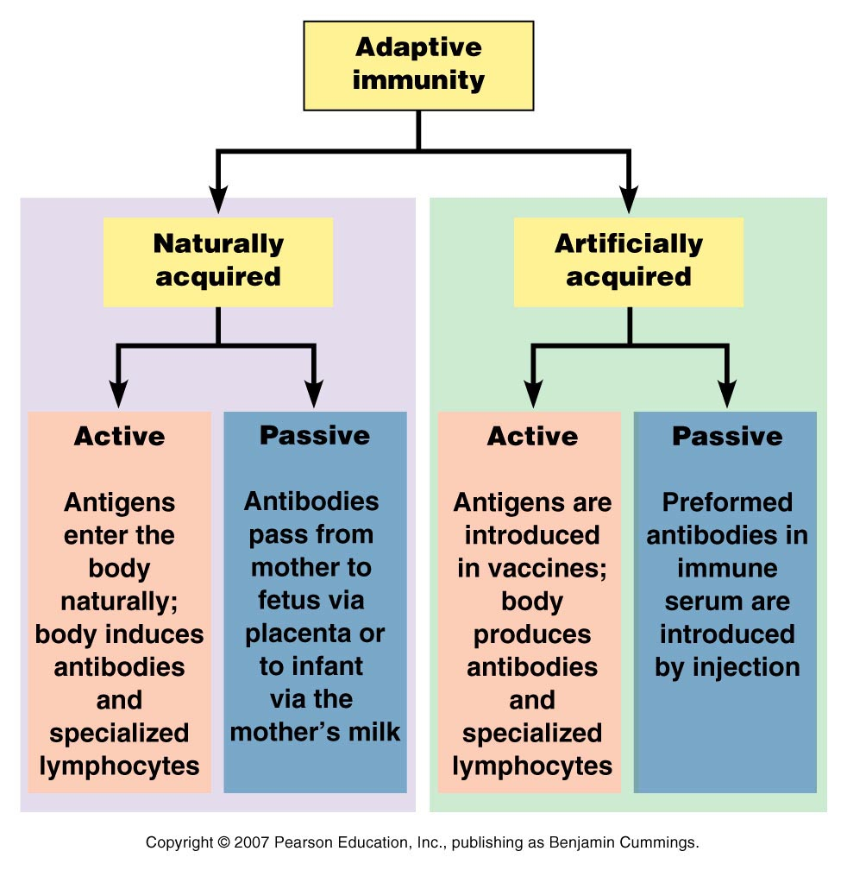
Fig. 17.17
Another great possible Essay! 4 types of adaptive immunity

