Slide 1
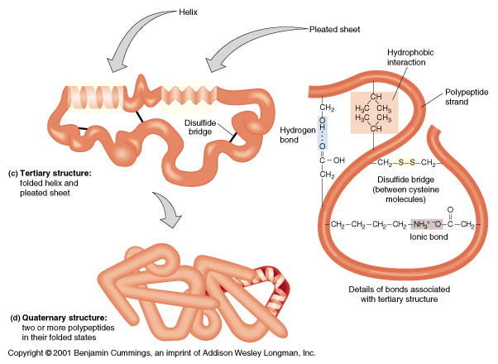

Slide 2
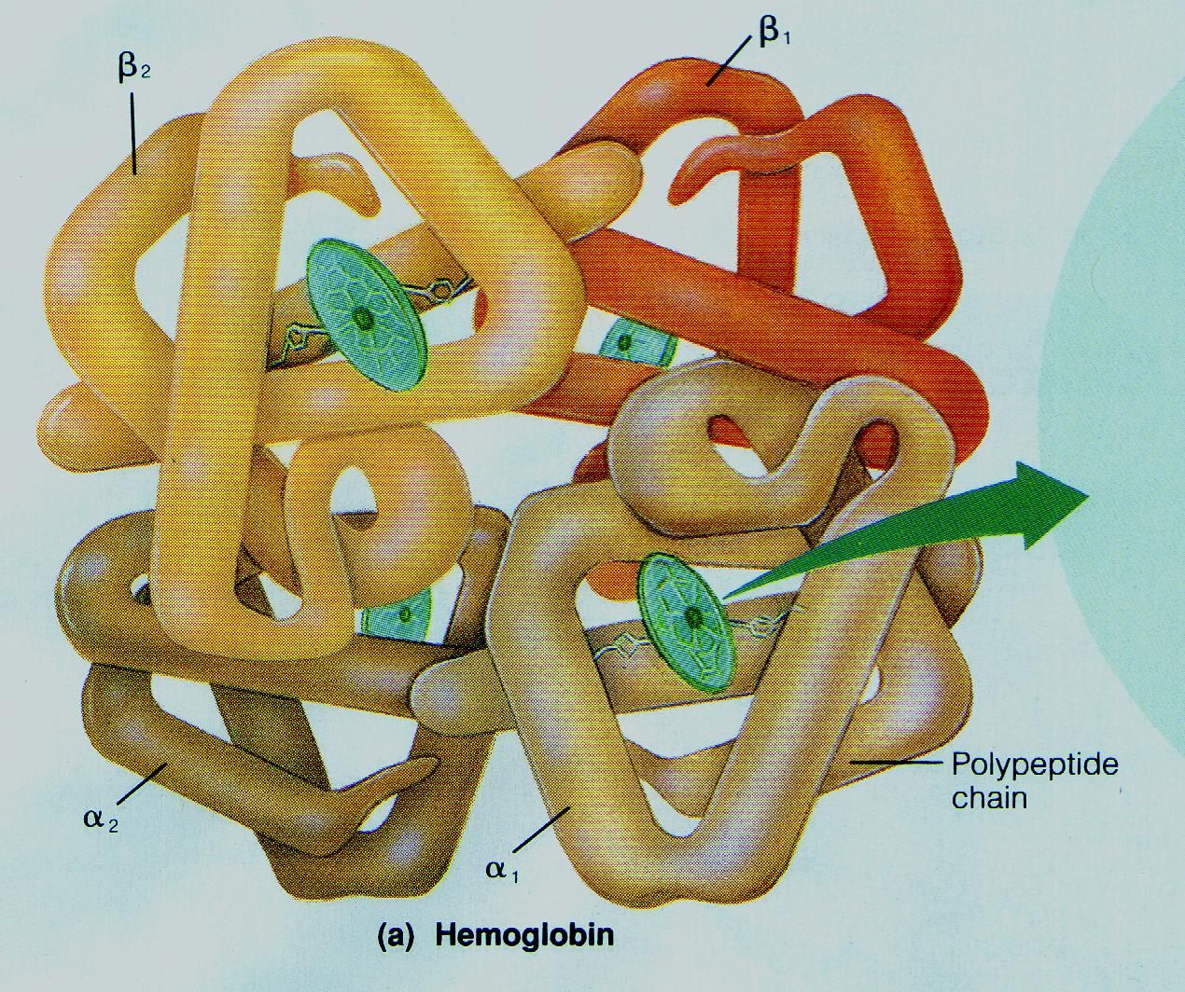
Protein structure: Quaternary (Hemoglobin)

Slide 3
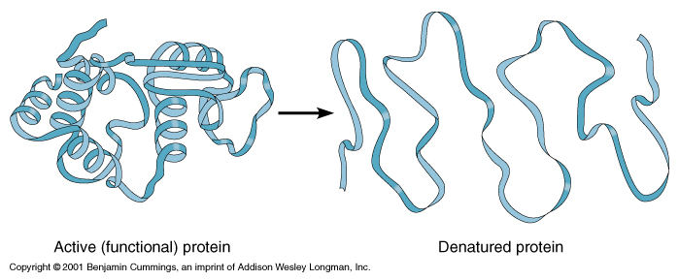
Protein _________
Denaturing
Altered 3-D shape = destroyed protein

Slide 4
I. MICROBIAL PHYSIOLOGY
Metabolism
_____________: the sum of all biochemical processes taking place in a living cell. Two phases:
_____________: constructive metabolism; the synthesis reactions; small molecules bonded into larger molecules; energy is “used up”
_____________: destructive metabolism; decomposition reactions; large molecules split into smaller molecules; energy is released
Anabolism
Catabolism

Slide 5
A._________
Enzymes
the enzymes present in an organism determine the nature of its physiology
enzymes are biological catalysts (catalysts are agents that speed up chemical reactions)
Enzymes “are reusable protein molecules that brings about a chemical change while remaining unchanged itself”
Notes:
Stopped on 26!

Slide 6
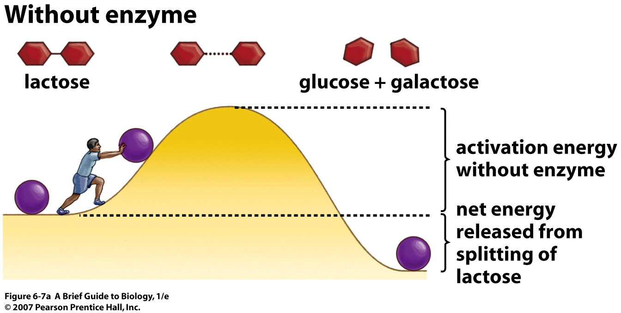
Activation energy
________________= the amount of energy required to do the reaction

Slide 7
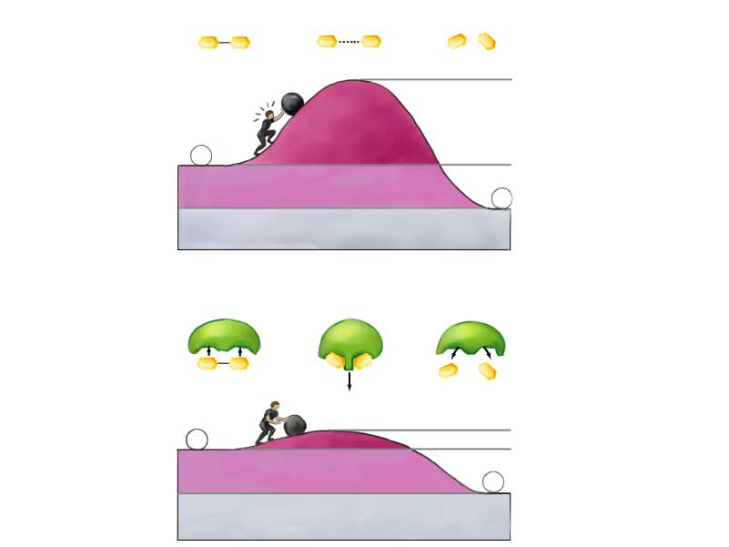
Without enzyme
lactose
glucose + galactose
activation energy
without enzyme
Enzymes = Proteins that speed up reactions by lowering the activation energy
net energy released
from splitting of lactose
Activation Energy = the amount of energy required to do the reaction
With enzyme
lactose
glucose +
galactose
activation energy
with enzyme
net energy released
Notes:
*
Title:
Enzymes accelerate chemical reactions.
Caption:
How is lactose split into glucose and galactose? Without an enzyme, the amount of energy necessary to activate this reaction is high. In the presence of the enzyme lactase, however, a low activation energy is sufficient to get the process started. The energy released from the splitting of lactose is the same in both cases.

Slide 8
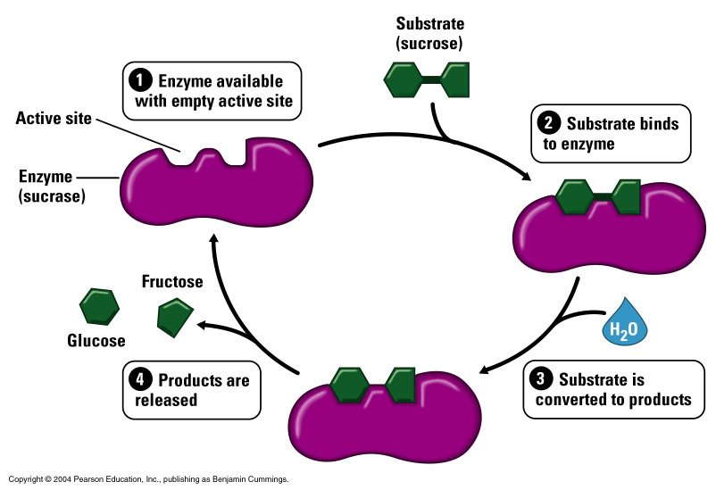
Substrate
__________ = what the enzymes works on
Enzymes
Product
________ = what is made
Notes:
Figure: 06-10a-b
Title:
When the product slows the reaction.
Caption:
The frequency of chemical reactions can be controlled by negative feedback. a. In step 1, the substrate (yellow circles) binds to the enzyme. This transforms the substrate, in step 2, into the product (the orange wedges). b. The product now binds to a different site on the enzyme (step 3), causing a conformational change in the enzyme that prevents it from binding with any more substrate (step 4).

Slide 9
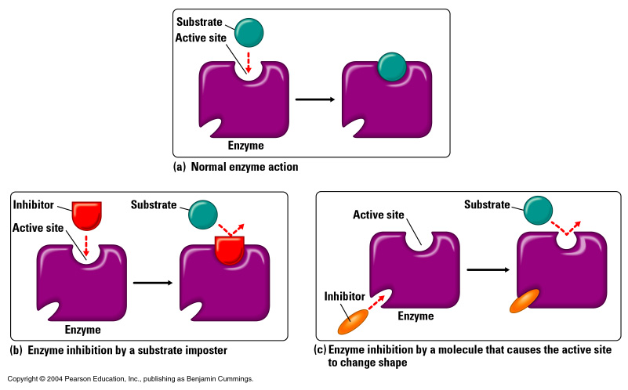
Enzymes
Active Site
Allosteric Site
Competitive Inhibitor Noncompetitive inhibitor

Slide 10
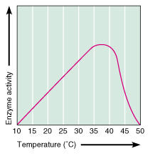
enzyme activity vs temperature

Slide 11
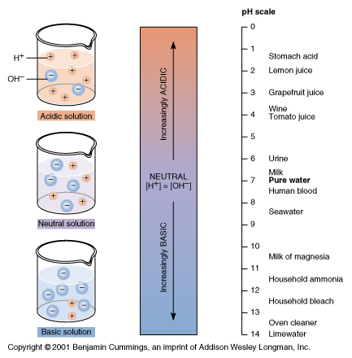
pH
Measurement of acid/base balance
Logarithmic scale
0-6.9 = acid
7.1-14 = basic (alkaline)
7 = neutral (like pure water)

Slide 12
Naming of enzymes
names end with -ase
name of substrate + ase e.g. sucrose is digested by sucrase
kind of reaction + ase e.g. an enzyme that causes oxidation is called oxidase

Slide 13
Types of Enzymes based on location
endoenzymes: remain inside of the cell (work internally)
enzymes of cellular metabolism
vulnerable enzymes
exoenzymes: released to the exterior of the cell (work externally)
digestive enzymes and enzymes of virulence

Slide 14
Constitutive vs Induced Enzymes
___________ enzymes:
always present
necessary for life of cell
__________ enzymes:
produced only when substrates are present
e.g. digestive enzymes
provide efficiency and adaptability
Constitutive
Induced

Slide 15
Classification of organisms by oxygen use (study table 6.1)
1. obligate aerobes: (= strictly aerobic): must have oxygen to grow (go dormant without oxygen)
2. microaerophiles: grow best at low oxygen levels (less than atmospheric)
3. facultative anaerobes: use oxygen if it’s present, but can also grow anaerobically (capable of growing at any oxygen level, but greater growth with oxygen present)
4. aerotolerant anaerobes: never use oxygen, but not inhibited by it
5. obligate anaerobes: grow only in absence of oxygen (inhibited by oxygen)

Slide 16
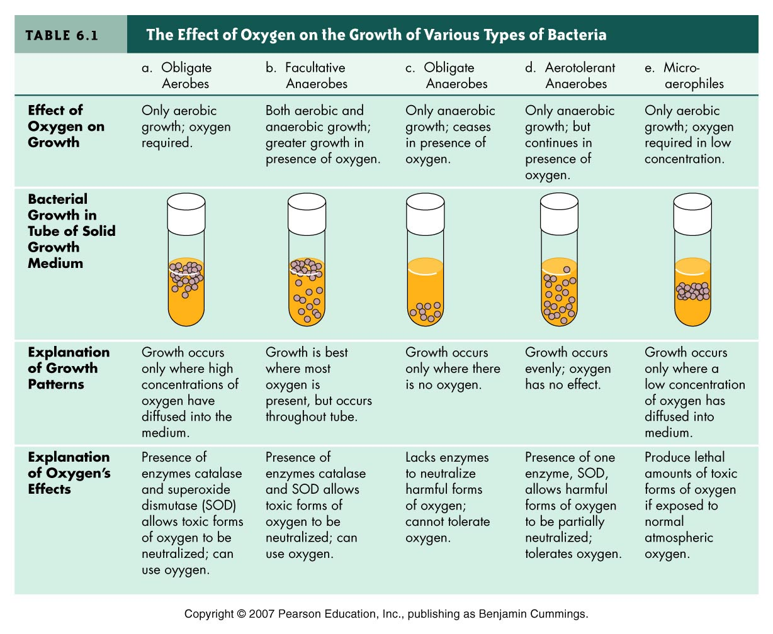
Growth at different oxygen levels

Slide 17
Growth speed vs temperature
Growth Speed

Slide 18
F. Classification by temperature requirements
_____________ (= cryophiles): cold-loving organisms; have optimum growth temp below 25° C
_____________ (meso = middle): have optimum of 25-40°C
____________: heat-loving organisms; have optimum > 40°C
______________: growth range = 70-105ºC; optimum > 90ºC
psychrophiles
mesophiles
thermophiles
hyperthermophiles

Slide 19
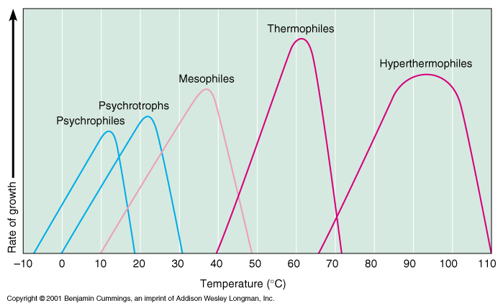
Growth versus temperature

